Slide 1
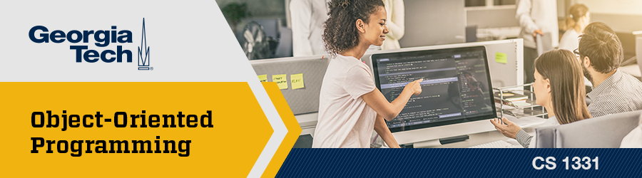
Recitation 15 /////

Slide 2
Announcements
Upcoming Due Dates:
HW09 (optional) is due today!
Office hours will be closed after today.
Ed Discussion will be closed Friday morning (12/6).
FINAL EXAM!
Section A/GR: Friday, 12/6 @ 08:00AM–10:50AM
Section B: Wednesday, 12/11 @ 08:00AM–10:50AM
Section C: Tuesday, 12/10 @ 02:40PM–5:30PM

Slide 3
Topics
Variables
Operators
Type conversion
Comments & debugging
Boolean expressions
  Short circuit evaluation
Conditionals
  if, else, else if
  ternary operator
  switch statement
Iteration (for loop, while loop, do-while loop)
Reference types
Strings, String comparison
Console I/O
  Console output: print(), println(), printf()
  Console input: Scanner
Packages
Math class and Random class
Enums
Static methods
Variable scope
Method overloading
  Ambiguous invocation
Arrays
  Multi-dimensional arrays
Aliasing
Pass-by-value
Objects
Classes
Constructors
this keyword
Instance vs. static
Encapsulation
Visibility Modifiers
NOTE: This is not a comprehensive list of topics. Refer to the Living Schedule for all topics that will be fair game on the exam.

Slide 4
Topics
Aliasing (revisited)
  Deep vs. shallow copy
Copy constructors
Wrapper classes
Inheritance
Object class
Overriding methods
protected and default visibility modifiers
Javadocs
Components of a good class
  equals()
  hashCode()
  toString()
Abstract classes
Polymorphism
Dynamic binding
Typecasting
Interfaces
Comparable
ArrayList
Introduction to generics
Asymptotics
Searching
Sorting
Recursion
Merge sort
Exceptions
File I/O
Generics
ADTs & the Collections framework
  List ADT
    LinkedList
  Stack ADT
  Queue ADT
  Set, Map, Tree
Iterable and Iterator
JavaFX basics
Layouts
Event-driven programming
Inner classes
Anonymous inner classes
Lambda expressions

Slide 5
Topics
Variables
Operators
Type conversion
Comments & debugging
Boolean expressions
  Short circuit evaluation
Conditionals
  if, else, else if
  ternary operator
  switch statement
Iteration (for loop, while loop, do-while loop)
Reference types
Strings, String comparison
Console I/O
  Console output: print(), println(), printf()
  Console input: Scanner
Packages
Math class and Random class
Enums
Static methods
Variable scope
Method overloading
  Ambiguous invocation
Arrays
  Multi-dimensional arrays
Aliasing
Pass-by-value
Objects
Classes
Constructors
this keyword
Instance vs. static
Encapsulation
Visibility Modifiers
NOTE: This is not a comprehensive list of topics. Refer to the Living Schedule for all topics that will be fair game on the exam.

Slide 6
Topics
Aliasing (revisited)
  Deep vs. shallow copy
Copy constructors
Wrapper classes
Inheritance
Object class
Overriding methods
protected and default visibility modifiers
Javadocs
Components of a good class
  equals()
  hashCode()
  toString()
Abstract classes
Polymorphism
Dynamic binding
Typecasting
Interfaces
Comparable
ArrayList
Introduction to generics
Asymptotics
Searching
Sorting
Recursion
Merge sort
Exceptions
File I/O
Generics
ADTs & the Collections framework
  List ADT
    LinkedList
  Stack ADT
  Queue ADT
  Set, Map, Tree
Iterable and Iterator
JavaFX basics
Layouts
Event-driven programming
Inner classes
Anonymous inner classes
Lambda expressions

Slide 7
Kahoot Links
Final Exam: https://create.kahoot.it/share/final-exam-review/d85f7cf4-720c-42dc-8b7e-c71e53c92c69
Exam 01: https://create.kahoot.it/share/exam-01-review/67c08e4f-a381-4f81-acb5-10ac849d22b6
Exam 02: https://create.kahoot.it/share/exam-02-review/c7bfc1b6-37c9-4b78-9b38-7978ea955509
Exam 03: https://create.kahoot.it/share/exam-03-review/6a0c1ec6-5e77-4250-b46a-3b026d12080f

Slide 8
Variables
A variable is a named piece of memory that stores a value.
Name: myInt
int myInt;
myInt = 5;
double x = 3.2;
5
Name: x
3.2

Slide 9
Variables
To declare a variable, specify the variable name and the type of data it stores. The data type must be specified, since the compiler will allocate memory based on the data type.
  dataType variableName; → int myInt;
To assign a value to a variable, use the assignment operator: =
  variableName = <value>; → myInt = 7;
Initialization is assigning an initial value to a variable.
  You can declare and initialize a variable in one line!
    int myInt = 7;
Name: myInt
7

Slide 10
Variable Naming Conventions
Requirements (enforced by compiler):
  Cannot be a reserved word (e.g. int, public, class, static, void)
  Cannot start with a number
  Cannot contain special characters or spaces
    $ and _ are allowed but discouraged
Conventions:
  Camel case (myInt, camelCaseVariableName)
  Choose descriptive names with clear meanings
    Example: speed = distance / time; is much more meaningful than c = a / b;

Slide 11
Practice: Variable Naming
For each variable name, determine the following: 1) Is it legal? 2) If so, is it a good variable name?
1. new
2. $x
3. PandaSize
4. _dataVariable
5. num_of_people
6. averageNum
illegal (reserved keyword)
legal (but not descriptive, so bad name)
legal (but not camelCase, so bad practice)
legal (but starts with an underscore, so discouraged)
legal (but camelCase is preferred over snake_case)
legal (descriptive and follows camelCase)

Slide 12
Variable Types
Variables are either primitive types or reference types (objects).
  You’ll learn much more about reference types in the upcoming weeks!
The value of a primitive variable is the data itself.
Name: x
10
The value of a reference variable is the address of another memory location.
Name: myDog
0x123ABC
0x123ABC
name: "Jack"
age: 8

Slide 13
Primitives
The value of a primitive variable is the data itself.
Java provides 8 primitive types:
  Integer numbers: byte, short, int, long
  Floating point numbers: float, double
  Other: char, boolean
Integer | Floating point | Other
byte: 8 bits |  | boolean: ?
short: 16 bits |  | char: 16 bits
int: 32 bits | float: 32 bits
long: 64 bits | double: 64 bits

Slide 14
Literals
A literal is a constant value that is hardcoded directly in a program.
Examples:
  int num = 7;
  boolean maybe = true;
  String name = "Beethoven";
  double gold = 55.81;
  float width = 12.34f;
Note: A floating-point literal is type double by default. You must use F or f to specify a literal of type float.

Slide 15
Immutability
The final keyword indicates that a variable is immutable.
  A variable that is declared final cannot be changed after it is initialized.
By convention, immutable variables are named with all uppercase letters and underscores between words.
  Example: final double EARTH_GRAVITY = 9.81;
final double PI = 3.14;
PI = 6.28; // COMPILE ERROR

Slide 16
Arithmetic Operators
Generally, arithmetic expressions in Java are evaluated the same way as normal arithmetic.
  Operators within parentheses are evaluated first.
  Multiplication, division, and remainder operators (* / %) are applied before addition and subtraction (+ -).
  If there are multiple operations with the same precedence, they are evaluated from left to right.
Note: Watch out for integer division! The result is truncated, not rounded.
  Example: 4 / 5 = 0

Slide 17
Compound Assignment Operators
We often want to modify the current value of a variable and assign the new value back to the same variable:
Arithmetic and assignment can be combined into a single operator!
Java supports several other compound assignment operators:
  += -= *= /= %=
count = count + 1;
count += 1;

Slide 18
Increment & Decrement Operators
We often need to increment or decrement a variable by 1. The ++ and -- operators are shorthand to do this.
The operators can be placed before or after the variable.
The location of the operator determines what value is returned by the expression. A prEfix operator returns the nEw value, and a pOstfix operator returns the Old value.
int i = 2, j = 8;
i++; // i becomes 3
j--; // j becomes 7
++i; --i; // PREFIX
i++; i--; // POSTFIX

Slide 19
Practice: Prefix & Postfix
A prEfix operator returns the nEw value.
A pOstfix operator returns the Old value.
int i = 5;
int j = i++; // What is the value of i?
// What is the value of j?
int k = ++i; // What is the value of i?
// What is the value of k?
i == 6
j == 5
i == 7
k == 7

Slide 20
Operator Precedence Chart
parentheses | ()
postfix | expr++ expr--
unary | ++expr --expr !
multiplicative | * / %
additive | + -
shift | << >> >>>
relational | < > <= >= instanceof
equality | == !=
logical AND | &&
logical OR | ||
ternary | ? :
assignment | = += -= *= /= %=

Slide 21
Type Conversion
You can convert a primitive value to a different type. There are two kinds of type conversions.
Widening conversion: less precise type → more precise type
  Java will automatically perform widening conversions.
  Example: int → double
Narrowing conversion: more precise type → less precise type
  A narrowing conversion must be performed explicitly because of the potential loss of information.
  Example: double → int

Slide 22
Casting
Implicit cast: performed automatically by Java
  Widening conversions can be performed implicitly.
  Example: double d = 5; // No need to do anything else!
Explicit cast: must be performed when there is a potential loss of data
  Enclose the destination type in parentheses
  Example: int x = (int) 1.44; // x == 1 due to truncation
Note: Casting does not change the value or type of the original operand. The cast operation returns a value of the desired type.

Slide 23
Example: Type Conversion
Assignment conversion: implicit casting for widening conversions
  double d = 10; // 10 is implicitly converted to double
Arithmetic promotion: if two operands have different types, the less precise type is implicitly cast to the wider type
  double sum = 2.5 + 5; // 5 is promoted to 5.0
Explicit casting: must be performed explicitly for narrowing conversions
  int pi = (int) 3.14159; // pi == 3 due to truncation

Slide 24
Comments
Single-line comments:
  // This is a single-line comment.
Block (multi-line) comments:
  /*
  * This is
  * a block
  * comment.
  */
  The asterisks in the middle lines are optional.

Slide 25
Debugging
Use print statements at various points in your program to print the current values of variables. This can help you determine which lines are not performing correctly.
When the compiler reports a compile error, read the error message carefully! It will tell you the type of error and the line of code where it occurred.

Slide 26
Topic Trivia
1. Which of the following are legal variable declarations?
A) int _myInt = 10;
B) double num = 10;
C) float 1stNum = 10f;
D) boolean $Alpha = false;
E) int a = 7;
int b = A + 2;
2. What executes the Java bytecode?
// legal, but using $ and _ is discouraged
// legal (implicit widening conversion)
// illegal (cannot start with number)
// legal, but using $ and _ is discouraged
// illegal (variable names are case-sensitive)
Java Virtual Machine (JVM)

Slide 27
Topic Trivia
3. Are the following statements legal? If so, what is the value of num in each case?
A) double num = 3 / 2.0;
B) double num = 3 / 2;
C) int num = 3 / 2;
D) int num = 3.0 / 2;
// legal; num == 1.5
// legal; num == 1.0
// legal; num == 1
// illegal

Slide 28
Boolean Logic Operators
Operator | Meaning | Description
&& | AND | Both operands must be true for the expression to be true.
|| | OR | At least one operand must be true for the expression to be true.
! | NOT | Reverses the value of a Boolean expression.
a | b | a && b
true | true | true
true | false | false
false | true | false
false | false | false
a | b | a || b
true | true | true
true | false | true
false | true | true
false | false | false
a | !a
true | false
false | true

Slide 29
Short Circuit Evaluation
Java will stop evaluating a Boolean expression when the outcome is guaranteed, even if the expression has not been completely evaluated.
  This minimizes unnecessary computations and improves performance.
  Short circuit evaluation can also help us avoid logic errors.
AND (&&): if the first operand is false, the second operand will not be evaluated, since the result is guaranteed to be false
OR (||): if the first operand is true, the second operand will not be evaluated, since the result is guaranteed to be true

Slide 30
Example: Short Circuit Evaluation
int num1 = 5;
int num2 = 10;
boolean mystery = (num1 / 0 == 0) && (num1 > num2);
// Does this code compile? Does it run?
// If so, what is the value of mystery?
This code compiles, but there is a runtime error:
Exception in thread "main" java.lang.ArithmeticException: / by zero

Slide 31
Example: Short Circuit Evaluation
int num1 = 5;
int num2 = 10;
boolean mystery = (num1 > num2) && (num1 / 0 == 0);
// Does this code compile? Does it run?
// If so, what is the value of mystery?
This code compiles and runs. Since num1 > num2 is false, the second expression will never be evaluated. Short circuit evaluation!
The value of mystery is false.

Slide 32
if Statements
An if statement executes a block of code if the specified condition is true.
An if statement can be followed by an else. The else block will be executed when the preceding if condition is false.
  The else block is optional. You can have an if without an else.
  Curly braces can be omitted if they enclose only one statement. Be careful when omitting curly braces! (more on this later…)
if (x % 2 == 0) {
System.out.println("x is even.");
} else {
System.out.println("x is odd.");
}
if (x % 2 == 0)
System.out.println("x is even.");
else
System.out.println("x is odd.");

Slide 33
else if Statements
An if-else statement creates two branches. We can create more branches with nested statements or with else if.
  Generally, else if is preferred over nested if-else statements.
if (score >= 90.0)
System.out.print("A");
else
if (score >= 80.0)
System.out.print("B");
else
if (score >= 70.0)
System.out.print("C");
else
if (score >= 60.0)
System.out.print("D");
else
System.out.print("F");
if (score >= 90.0)
System.out.print("A");
else if (score >= 80.0)
System.out.print("B");
else if (score >= 70.0)
System.out.print("C");
else if (score >= 60.0)
System.out.print("D");
else
System.out.print("F");

Slide 34
if Statements Without Braces
Curly braces can be omitted only if the block contains a single statement. If the block contains more than one statement, it must be enclosed with curly braces!
  Indentation doesn’t matter!
  The following examples are equivalent. "added" will always be printed.
if (num < 0)
num += 10;
System.out.println("added");
if (num < 0) {
num += 10;
}
System.out.println("added");

Slide 35
if-else Without Braces
If there are no curly braces, a dangling else clause matches the most recent unmatched if statement. Again, indentation doesn’t matter!
  The following examples are equivalent.
if (grade > 60)
if (grade > 90)
System.out.println("A");
else
System.out.println("Fail!");
if (grade > 60) {
if (grade > 90) {
System.out.println("A");
} else {
System.out.println("Fail!");
}
}

Slide 36
Best Practices
How can we improve this code?
int tuition;
boolean inState = true;
if (inState == true) {
tuition = 10;
Avoid redundantly testing boolean values.
if (inState) {
System.out.println("Your tuition costs $" + tuition + ".");​
} else {​
Avoid duplicating code.
tuition = 100000;
System.out.println("Your tuition costs $" + tuition + ".");​
}

Slide 37
Ternary Operator
The ternary operator requires three operands. It is shorthand for an if-else statement.
Example:
[boolean expression] ? [executed if true] : [executed if false]
String s = (x % 2 == 0) ? "x is even" : "x is odd";
String s;
if (x % 2 == 0) {
s = "x is even";
} else {
s = "x is odd";
}
These two code segments function identically. The ternary operator can express simple if-else statements very concisely.

Slide 38
switch Statement
A switch statement is used to branch into numerous cases based on the value of a discrete variable.
switch (variable) {
case value1:
// statements
break;
case value2:
// statements
break;
default:
// statements
break;
}
The switch expression must be a byte, short, int, char, or String.
Each case must be a literal of the same type as the variable.
The default case is optional. It is executed if the expression does not match any of the other cases.

Slide 39
Example: switch Statement
char letterGrade = 'A';
switch (letterGrade) {
case 'A':
System.out.println("90-100");
break;
case 'B':
System.out.println("80-89.99");
break;
case 'C':
System.out.println("70-79.99");
break;
case 'D':
System.out.println("60-69.99");
break;
case 'F':
System.out.println("0-59.99");
break;
default:
System.out.println("Invalid grade.");
}

Slide 40
Fall Through Behavior
Each case is an entry point.
  Fall through behavior: When the expression matches a case, subsequent lines will be executed until either a break statement or the end of the switch statement.
A break statement immediately exits the switch statement.
  break is optional, but you should break at the end of each case to prevent fall through!
The default case is executed when no other cases match or as a casualty of fall through.
  By convention, we put the default case at the bottom, but it can be placed anywhere.

Slide 41
Example: Fall Through
switch (month) {
default:
System.out.println("28 (sometimes 29) days");
case "January":
case "March":
case "May":
case "July":
case "August":
case "October":
case "December":
System.out.println("31 days!");
break;
case "April":
case "June":
case "September":
case "November":
System.out.println("30 days");
}
What is the output if month is "December"?
31 days!

Slide 42
Example: Fall Through
switch (month) {
default:
System.out.println("28 (sometimes 29) days");
case "January":
case "March":
case "May":
case "July":
case "August":
case "October":
case "December":
System.out.println("31 days!");
break;
case "April":
case "June":
case "September":
case "November":
System.out.println("30 days");
}
What is the output if month is "February"?
28 (sometimes 29) days!
31 days!

Slide 43
while Loops
A while loop executes statements repeatedly while the condition is true.
The condition is evaluated before each iteration.
  If the condition is true, the loop body is executed.
  If the condition is false, the loop terminates.
To prevent an infinite loop, ensure that the condition will eventually be false.
while loops are useful when you don’t know how many times the loop must be executed.
while (condition) {
// loop body
}

Slide 44
for Loops
To perform a particular number of iterations with a while loop:
We can express this more concisely with a for loop!
int i = 0;
while (i < 10) {
// loop body
++i;
}
for (int i = 0; i < 10; ++i) {
// loop body
}

Slide 45
for Loops
A for loop has three components: initialization, condition, and update.
  Initialization is executed exactly once, before anything else.
  The condition is checked before every iteration.
  The update is executed after every iteration.
for loops are useful when you know exactly how many times to iterate.
Note: A for loop can always be converted to a while loop and vice versa.
initialization
while (condition) {
// loop body
update
}
for (initialization; condition; update) {
// loop body
}

Slide 46
do-while Loops
Like the while loop, a do-while loop executes statements repeatedly while the condition is true.
The difference is that the loop body is executed first, and the condition is evaluated after each iteration.
  This means that the loop body will always be executed at least once.
do-while loops are useful when you want to execute a block of code at least once.
do {
// loop body
} while (condition);

Slide 47
break and continue
break
  Immediately terminates the loop.
  Program control goes outside the closing curly brace.
continue
  Skips to the end of the current iteration but does not exit the loop.
  Program control goes just before the closing curly brace.
for (int i = 0; i < 16; i++) {
if (i % 2 == 0) {
continue;
}
if (i >= 10) {
break;
}
}

Slide 48
Topic Trivia
What type of conversion is attempted in the each of the following lines of code? Is the conversion legal?
2. (T/F) In Java, if you have an if block, it must be followed by an else block.
3. What is the value of myNum after the following code executes?
int myNum = (7 + 3 == 12) ? 1 : 0;
double num = 10;
int num2 = num;
Line 1: implicit widening, legal
Line 2: narrowing, illegal (compile-time error)
false
myNum == 0

Slide 49
Topic Trivia
4. What are the three components of a for loop statement?
5. Convert the following for loop to a while loop:
for (int i = start; i >= end; --i) {
// loop body
}
initializer, condition, update
int i = start;
while (i >= end) {
// loop body
--i;
}

Slide 50
Topic Trivia
6. (T/F) If an if block executes, the else if and else blocks will also execute.
7. Evaluate the following Boolean expressions:
a) true || (false && true)
b) true && (false || (true && !false))
false
true
true

Slide 51
Reference Type Variables
Reference type variables store a reference (i.e., an address) that points to the location of an object in memory. Primitive type variables store the data itself.
Primitive Types | Reference Types
int x = 5;
double gpa = 4.0;
boolean isEmpty = true;
String str = new String("hello");
Address
Name
Value
Address
Name
Value
0x123ABC
x
5
0x456DEF
str
0x123ABC
0x456DEF
gpa
4.0
0x123ABC
"hello"
0x789012
isEmpty
true

Slide 52
Diagramming Variables
A box represents a block of memory. Variables are labeled with a name, and objects are labeled with an address. An arrow indicates where a reference variable points.
Primitive Types | Reference Types
int x = 5;
double gpa = 4.0;
boolean isEmpty = true;
String str = new String("hello");
0x123ABC
0x456DEF
0x456DEF
x
str
gpa
5
0x123ABC
4.0
0x789012
0x123ABC
isEmpty
"hello"
true

Slide 53
Reference Type Variables
By convention, reference types start with an uppercase letter to differentiate them from primitive types.
Initialization:
String str = new String("hello");
0xABC123
"hello"
str
0xABC123
This is the object itself, elsewhere in memory.
str is the reference type variable.

Slide 54
null Keyword
null is a reserved keyword that indicates that a reference variable does not point to any instance.
  Attempting to access a null reference will cause a NullPointerException at runtime.
To avoid NullPointerExceptions, check that a reference is not null before using it to invoke methods.
  Short-circuit evaluation can be useful here!
The reference variable s does not point to any String object!
String s = null;
if (s != null && s.length() > 0) {
// do something
}
s
null

Slide 55
Strings
Strings are reference types, not primitive types.
A String represents a sequence of characters.
Examples of String literals:
"hello"
"A" // double quotes => String, NOT char
"5"
"!!!"
"" // empty string (contains no characters)
" " // blank string (only whitespace characters)

Slide 56
String Concatenation
Concatenation is joining multiple strings to form a single string.
+ operators are evaluated from left to right. Whether it performs addition or concatenation depends on the operands.
What is the result of the following operations?
"HELLO!"
1) "HELLO" + "!"
2) "12" + "3"
3) "12" + 3
4) "12" + 1 + 2
5) 1 + 2 + "3"
"1212"
"123"
"123"
1. concatenation
2. concatenation
"33"
concatenation
1. int addition
2. concatenation

Slide 57
String Instantiation
1) Heap instantiation: When the new operator is used, the JVM allocates memory and returns the reference.
String str1 = new String("1331");
String str2 = new String("1331");
0xABC123
str1
"1331"
0xABC123
0x987FED
str2
"1331"
0x987FED
2) String literal pool: If a literal already exists in the pool, the JVM returns a reference to that instance instead of allocating additional memory.
String str1 = "hello";
String str2 = "hello";
String Literal Pool
str1
"hello"
"no"
"goodbye"
0xABCDEF
str2
0xABCDEF

Slide 58
String Immutability
String objects are IMMUTABLE! Once a String object has been created, it cannot be modified.
The string literal pool optimizes memory usage by reusing String objects that have already been created.
  This is only possible because String objects are immutable.
The String class includes many methods that appear to modify strings. Instead, these methods are creating and returning an entirely new string.
String str1 = "hello";
str1 = str1.toUpperCase();
0xABC123
str1
"hello"
0xABC123
0x987FED
0xABC123
0x987FED
"HELLO"

Slide 59
String Methods
Again, String methods do not modify strings! They return the reference to a new String object containing the result of the operation.
If you want to save the result, you must assign the return value to a String reference variable.
String str = "hello";
str.toUpperCase();
System.out.println(str);
0xABC123
str
"hello"
0xABC123
// prints "hello", not "HELLO"
0x987FED
str.toUpperCase() creates this object, but its reference is never assigned back to str!
"HELLO"

Slide 60
String Methods
Java 11 String API (docs.oracle.com)
Refer to the Java String API to learn about all available methods.
Some examples of frequently used methods:
  char charAt(int index)
  int indexOf(char c)
  int length()
  String replace(char oldChar, char newChar)
  String substring(int beginIndex)
  String substring(int beginIndex, int endIndex)
  String toLowerCase() / toUpperCase()
  int compareTo(String otherString)
  boolean equals(String otherString)

Slide 61
Example: String Methods
// Two ways to create a String
String str = "Welcome to Recitation 02";
String str2 = new String("Welcome to Recitation 02");
str = str.toLowerCase();
str.toUpperCase();
str = str.replace("2", "4");
str.replace("4", "2");
System.out.println(str); // What is the output of this code?
// str now references an all-lowercase string
// does not modify str
// replaces each occurrence of "2" with "4"
// does not modify str
Output: welcome to recitation 04

Slide 62
Black Box Abstraction
In computer science, a black box is some code that performs a function.
Black boxes have three main characteristics:
  The interface/contract of the black box must be well-defined.
  The user of a black box should not need to know about the implementation.
  The implementer of a black box should not need to know about the user.
Black boxes are called "black boxes" because the user does not need to see what is inside, as long the box functions according to the contract.

Slide 63
Example: Black Box Abstraction
We can think of the String methods as black boxes!
When you invoke "hello".toUpperCase, you are the user and Java is the implementer. The method contract (or interface) is the description of the method in the Java API. It states that the method will take in a String, create a new String with all uppercase letters, and return a reference to the new String.
You fulfill your end of the contract by providing a String. You can trust that Java will fulfill its end of the contract by returning the correct String.
"hello"
"HELLO"
toUpperCase()

Slide 64
compareTo()
Primitive types are compared with equality and relational operators (== < > <= >= etc.). How do we compare reference types?
str1.compareTo(str2) compares two strings lexicographically (based on the Unicode value of each character)
compareTo() Method Contract
Input | Return Value
str1 and str2 are identical | 0
str1 precedes str2 | integer less than 0
str1 follows str2 | integer greater than 0

Slide 65
Practice: compareTo()
Will each line's output be negative, zero, or positive?
1) "abacus".compareTo("zebra")
2) "dog".compareTo("cat")
3) "hello".compareTo("hello")
4) "science".compareTo("Tech")
5) "BANANA".compareTo("banana")
< 0
> 0
== 0
> 0
< 0

Slide 66
equals()
Strings can also be compared using the equals() method:
str1.equals(str2);
equals() compares the actual state of the strings
  returns true if two strings represent identical character sequences
== compares references
  returns true only if two reference variables contain addresses to the exact same object in memory
  returns false otherwise, even if the character sequences are identical!

Slide 67
Example: equals()
str1 == str2 compares references!
str1
str2
0xABC123
0xDEF456
String str1 = new String("hello");
String str2 = new String("hello");
str1 == str2;
str1.equals(str2);
// false
// true
0xABC123
0xDEF456
"hello"
"hello"
str1.equals(str2) compares the contents of the strings!

Slide 68
Practice: String Comparison
String s1 = "abc"; // 'a' Unicode: 97
String s2 = "ABC"; // 'A' Unicode: 65
System.out.println(s1.compareTo(s2)); // What is printed?
System.out.println(s2.compareTo(s1)); // What is printed?
s1.toUpperCase();
System.out.println(s1.compareTo(s2)); // What is printed?
System.out.println(s1.equals(s2)); // What is printed?
System.out.println(s1 == s2); // What is printed?
32
-32
32
false
false

Slide 69
Practice: Strings
1. What value does myStr reference?
String myStr = new String("Java is fun!");
myStr.replace('a', 'z');
myStr.toUpperCase();
2. What will be printed to the console?
String s1 = "I love CS 1331!";
String s2 = new String("I love CS 1331!");
String s3 = "I love CS 1331!";
System.out.println(s1 == s2); // 1.
System.out.println(s1 == s3); // 2.
System.out.println(s1.equals(s2)); // 3.
"Java is fun!"
false
true
true

Slide 70
Console Output
System.out.print() – prints on the current line. Does not append a newline character.
System.out.println() – prints on the current line and appends a newline character ('\n') at the end
System.out.printf() – prints with formatting depending on the format specifiers. Does not append a newline character.

Slide 71
Example: Console Output
String name = "Buzz";
int age = 5;
double gpa = 4.0;
System.out.println("Name: " + name + "; Age: " + age + "; GPA: " + gpa);
Concatenating many elements together can be tedious and lengthy. How can we improve this code?
System.out.printf("Name: %s; Age: %d; GPA: %.2f%n", name, age, gpa);
printf() uses format specifiers as placeholders to display arguments of different types. We can format complex output by specifying details like spacing, alignment, and precision.

Slide 72
printf Format Specifiers
Format specifier syntax: begin with % and end with conversion character
  flags (optional) – modifies the output format
  width (optional) – specifies the minimum number of characters in the output
  precision (optional) – usually restricts the number of characters (specific behavior depends on the conversion character)
  conversion character (required) – indicates the type of conversion to perform based on the type of the argument
See the Formatter API for detailed documentation.
%[flags][width][.precision]conversion-character

Slide 73
printf Conversion Characters
%[flags][width][.precision]conversion-character
Conversion characters
  's' – argument is formatted as a string
  'd' – argument is formatted as a decimal integer
  'f' – results in a floating-point value
  'b' / 'B' – results in false/FALSE or true/TRUE
  'c' – results in a Unicode character

Slide 74
Numeric printf Example
%[flags][width][.precision]conversion-character
System.out.printf("%9.3f", 3.14);
'9' – specifies the minimum width of the formatted floating point number (including the decimal point!)
'.3' – specifies how many decimal places the formatted number is rounded to
'f' – conversion character
_ _ _ _ _ . _ _ _
1 2 3 4 5 6 7 8 9
_ _ _ _ 3 . 1 4 0
4 spaces are appended to the left

Slide 75
Practice: printf
double num = 3.456;
System.out.printf("%.2f is a %s number.",
num, (num > 10) ? "big" : "small");
// What is printed?
3.46 is a small number.

Slide 76
Console Input: Scanner
The Scanner class allows us to create Scanner objects that can read user input from the console or read from files.
  To use Scanner, you must import java.util.Scanner; before the class declaration.
A Scanner reads input as tokens separated by delimiters.
  By default, whitespace and newlines are used as delimiters.
To instantiate a Scanner that reads user input from the console:
Note: You should only create one Scanner object for an input source!
Scanner scan = new Scanner(System.in);

Slide 77
Useful Scanner Methods
Method | Functionality (Method Contract)
hasNext() | Returns true if the Scanner has another token in its input
hasNextLine() | Returns true if the Scanner has another line in its input
next() | Scans and returns the next complete token as a String
nextLine() | Scans the next line as a String
nextInt() | Scans the next token as an int
nextDouble() | Scans the next token as a double
Java 11 Scanner API (docs.oracle.com)

Slide 78
Packages
A package is a collection of related classes. You can think of it as a folder.
To import a class, you must specify what package it is in.
  Example: import java.util.Scanner;
List of some packages included with the Java API:
  java.lang // (implicitly imported)
  java.util
  java.io
You can import an entire package using wildcard import.
  import java.util.*;
  Do NOT use wildcard import in this course! To avoid naming conflicts, you should import individual classes as needed.
The Scanner class is in the java.util package.

Slide 79
Math Class
Part of the java.lang package—no need to explicitly import!
Contains many useful static methods (invoked with class name):
  Math.sqrt(double a)
  Math.round(double a)
  Math.min(double a, double b)
  Math.max(double a, double b)
  Math.pow(double a, double b) //
  Math.abs(double a) // absolute value
Important method:
Math.random() // returns a pseudo-random double in range of [0.0, 1.0)
Java 11 Math API (docs.oracle.com)

Slide 80
Random Class
Part of the java.util package—must be explicitly imported!
Random allows pseudo-random number generation with more customization.
You must instantiate a Random object to invoke methods!
Random rand = new Random();
Useful instance methods (invoked with instance name):
  rand.nextInt(); // returns an int in the range [−2147483648, 2147483647]
  rand.nextInt(int bound); // returns an int in the range [0, bound)
  rand.nextDouble(); // returns a double in the range [0.0, 1.0)
Java 11 Random API (docs.oracle.com)

Slide 81
Practice: Random Numbers
1. What range of numbers is generated by the following code?
(int) (Math.random() * 40) + 60
2. What should the values of x and y be to generate integers in the range [1, 10]?
Random rand = new Random();
rand.nextInt(x) + y;
[60, 100)
x = 10
y = 1
Watch out for exclusive () and inclusive boundaries [] when generating pseudo-random numbers!

Slide 82
Enums
An enum is a special data type that ensures the value of a variable is one of a list of predefined constants.
Lists all possible values so that errors can be caught at compile time:
public enum Season {
SPRING, SUMMER, FALL, WINTER
}
Useful enum methods:
  name() – returns the name of the enum constant in String format
    Season.SUMMER.name() → "SUMMER"
  ordinal() – returns the index of the enum constant in its declaration
    Season.SUMMER.ordinal() → 1
  values() – returns an array containing all enum constants
    Season.values() → [Season.SPRING, Season.SUMMER,
Season.FALL, Season.WINTER]

Slide 83
Methods as Black Boxes
Methods are a way of defining black boxes. If a task needs to performed many times, you can delegate this task to a method instead of rewriting the same code each time.
  This allows you to build complex programs that are readable, reliable, and maintainable.
To define a black box, we must write a contract.
Components of a method contract:
  Method name
  Parameters: inputs (how many inputs? what are their types?)
  Return type: output (what type?)

Slide 84
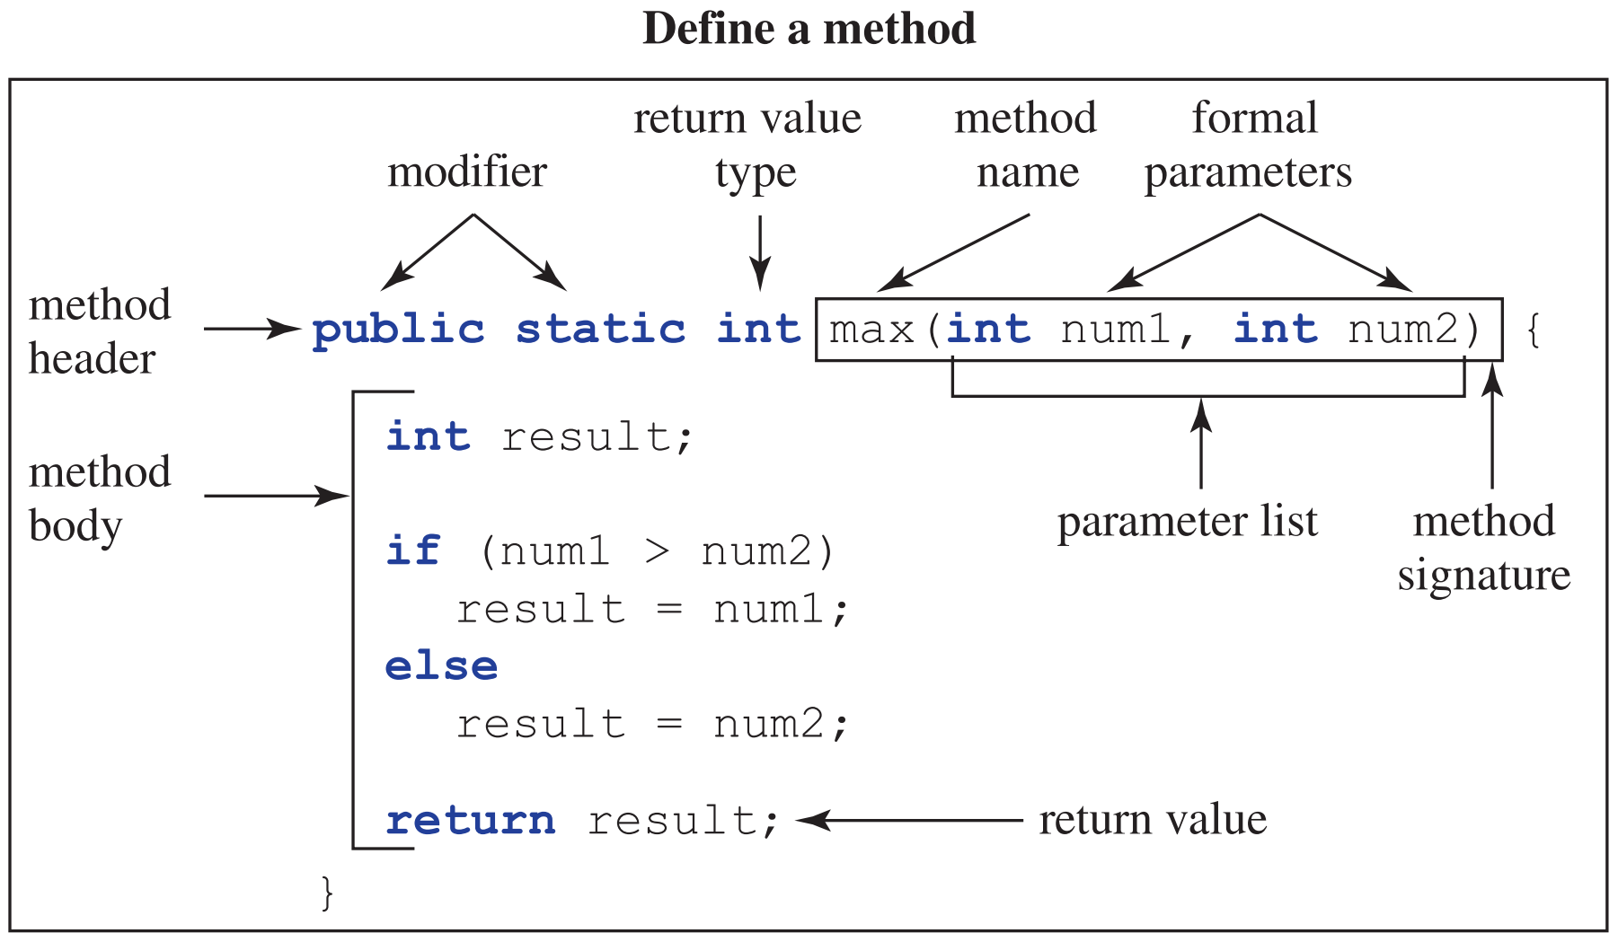
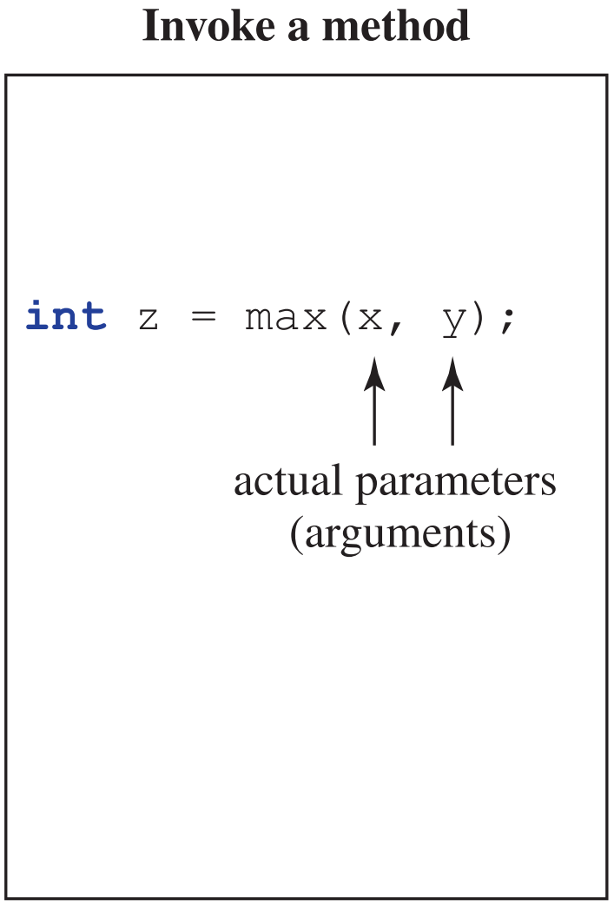
Defining Methods
Implementer
User
Implementation
A method header consists of modifiers, return value type, method name, and parameters.
A method signature consists of a method name and type of parameters (parameter list).

Slide 85
static Methods
Static methods have the static modifier in the method header.
  public static void main(String[] args) {...}
  public static int myMethod(int someParameter) {...}
Static methods are not tied to a specific object and can be invoked with the class name.
To invoke a static method, use the class name and the dot operator:
ClassName.methodName(arguments)
  Example: Math.random()

Slide 86
Practice: static Methods
1. What is the method header for a static method named sum that accepts an int and a double as parameters and returns a double?
public static double sum(int a, double b)
2. What is the method signature of the above method?
sum(int, double)
3. How do you invoke a static method named run that takes no arguments defined in a class named Test?
Test.run()

Slide 87
Topic Trivia
What is printed to the console?
System.out.printf("You ordered %s burgers for $%8.2f.", 5, 300.4899);
The Scanner class is contained in the java.lang package. (T/F)
Do the following pairs of methods have the same signature?
  public static int foo(int a, int b) { … }
  private int foo(int a, int b) { … }
  public static int bar(int a, double b) { … }
  public static int bar(int x, double y) { … }
You ordered 5 burgers for $ 300.49.
false
Yes
Yes

Slide 88
Variable Scope
The scope of a variable is the section of code where the variable can be accessed. What is the scope of each of these variables?
x: anywhere in MyClass
1
2
3
4
5
6
7
8
9
public class MyClass {
int x;
public static void main(String[] args) {
int y;
for (int i = 0; i < 10; ++i) {
int z;
}
}
}
y, args: inside the main method
i, z: inside the for loop

Slide 89
Scope
The scope of a variable is determined by where it is declared.
A variable declared inside a method is called a local variable. The scope of a local variable starts from its declaration and continues to the end of the block that contains the variable.
  Method parameters are local variables!
  Note: A local variable must be initialized before it is used.
The scope of instance fields and static fields is the entire class.
  Note: An uninitialized field will be set to a default value by the compiler, but it is considered bad practice to rely on default values.

Slide 90
Practice: Scope
for (int i = 0; i < 10; i++) {
System.out.println(i);
}
1. What is the scope of i?
inside the for loop
public static int randGenerator(int num) {
Random myRand = new Random();
return myRand.nextInt(num);
}
2. (a) What is the scope of num?
inside randGenerator()
(b) What is the scope of myRand?
inside randGenerator()
public class MyClass {
private final int CURR_YEAR = 2020;
public void tellFuture(int year) {
if (year > CURR_YEAR) {
boolean future = true;
}
}
}
3. (a) What is the scope of CURR_YEAR?
inside MyClass
(b) What is the scope of future?
inside the if block

Slide 91
Method Overloading
Methods within the same class cannot have the same method signature. Each method can only have one definition.
However, method overloading is allowed—multiple methods can have the same name as long as they have different parameter lists and thus different signatures.
// signature: subtract(int, int)
public static int subtract(int a, int b) {
return a - b;
}
// signature: subtract(double, double)
public static double subtract(double a, double b) {
return a - b;
}

Slide 92
Invoking Overloaded Methods
public class Overloaded {
public static double multiply(int a, double b) { // body }
public static double multiply(double a, double b) { // body }
public static void main(String[] args) {
multiply(2, 5.0); // Which method is invoked?
multiply(2, 5); // Which method is invoked?
}
}
multiply(int, double)
multiply(int, double)

Slide 93
Invoking Overloaded Methods
The compiler determines which method to call based on the information at the call site (where the method is invoked).
  The only information available at the call site is the method name and the types of the arguments passed in by the user.
  Example: multiply(2, 5.0);
If the argument list does not exactly match any parameter list, the compiler will invoke the method that requires the fewest implicit conversions.

Slide 94
Ambiguous Invocation
If no method matches the call site exactly, and two methods require the same number of conversions, then the compiler cannot determine which method to invoke compile error!
public static void main(String[] args) {
sum(1, 2); // AMBIGUOUS INVOCATION! Compile error!
}
public static double sum(int a, double b) {
return a + b;
}
public static double sum(double a, int b) {
return a + b;
}

Slide 95
Motivation for Arrays
Suppose we want to compute the average course grade of all the students in CS 1331. How can we accomplish this with code?
Makeshift solution:
Issues:
  What if there are 800 students? We would have to write the same code 800 times to declare 800 different variables.
// Suppose there are only 5 students in CS 1331.
int score1 = 75;
int score2 = 82;
int score3 = 93;
int score4 = 97;
int score5 = 88;
double avg = (score1 + score2 + score3 + score4 + score5) / 5.0;

Slide 96
Arrays
Arrays allow us to store an ordered collection of elements of the same type in one continuous block of memory.
Instead of declaring many variables (score1, score2, score3,…), we only need to declare one variable for the entire array (scores)!
We can access any element by its index (scores[0], scores[1], scores[2],…).
Element at index 8
75 | 82 | 93 | 97 | 88 | 98 | 61 | 89 |  | 95
94
Index:
0 | 1 | 2 | 3 | 4 | 5 | 6 | 7 | 8 | 9
0
Arrays are zero-indexed.
The first index is 0.

Slide 97
Array Declaration
Arrays are objects.
  Declaring an array variable does not actually allocate memory for the data. It simply allocates a place to store a reference to an array.
Array declaration syntax: elementType[] arrayRefName;
  elementType can be any data type—primitive or reference!
  All elements in the array must be of the same type. We say that arrays are homogeneous.
  Example: String[] studentNames;

Slide 98
Array Instantiation
The length of an array can never be modified after the array has been created.
There are three ways to instantiate an array. Notice that the length of the array must be specified—either explicitly or implicitly.
  int[] grades = new int[5];
    The length is explicitly specified in the square brackets.
  int[] grades = new int[]{75, 82, 93, 97, 88};
    The length is implicitly specified by the number of elements listed.
  int[] grades = {75, 82, 93, 97, 88};
    This syntax is a convenient shorthand, but you must declare and initialize the array in one line.

Slide 99
Creating an Array
int[] grades;
grades = new int[5];
grades[0] = 75;
grades[1] = 82;
grades[2] = 93;
grades[3] = 97;
grades[4] = 88;
grades
0xABC123
0xABC123
0 | 0 | 0 | 0 | 0
75
82
93
97
88
Index:
0 | 1 | 2 | 3 | 4

Slide 100
Array Length
You can obtain the length (capacity) of an array using the length variable:
  For example, grades.length is 5.
  Note: length is a variable, not a method!
If you do not explicitly initialize the elements of an array, they will be assigned default values depending on type.
int | double | boolean | char | Reference
0 | 0.0 | false | '\u0000' | null

Slide 101
Processing Arrays
Now that the class score data is conveniently stored in an array, how can we process this data to compute the average score?
It is often convenient to use for loops to process arrays, since the length of the array is known.
  We often perform operations on each element of an array. Accessing each element one at a time is called iterating over the array.
int total = 0;
for (int i = 0; i < scores.length; ++i) {
total += scores[i];
}
double avg = (double) total / scores.length;

Slide 102
for-each Loop
The for-each loop is a special loop that iterates over arrays and other collections of data (we’ll discuss these in the future!).
Benefits:
  Simple syntax
  Reduces risk of an “off-by-one” error (iterating too many or too few times)
Limitations:
  Can only iterate forward, one element at a time, over the entire array
  IMPORTANT: Cannot be used to modify the array!
int total = 0;
for (int score : scores) {
total += score;
}
Read as “for each score in scores, do the following…”

Slide 103
Multi-Dimensional Arrays
Arrays can store reference types, and arrays are reference types, so an array can store arrays!
A 2D array is simply an array of arrays:
int[][] arr2D = new int[rows][cols];
The number of rows must be specified, but number of cols is optional.
To access an element in a 2D array, specify its row and column indices.
arr2D
int[][] arr2D = { {1, 2, 3},
{4, 5, 6},
{7, 8, 9} };
arr2D[1][2]; // value: 6
1 | 2 | 3
arr2D[0]
arr2D[1]
4 | 5 | 6
arr2D[2]
7 | 8 | 9

Slide 104
Multi-Dimensional Arrays
Each row of a 2D array is a 1D array, so each row can have a different number of elements.
rectangular array – all rows have the same length
int[][] rectangular = { {1, 2, 3, 4},
{5, 6, 7, 8}
{9, 10, 11, 12} };
jagged array – rows have different lengths
int[][] jagged = { {1, 2, 3, 4},
{5, 6, 7},
{8, 9},
{10} };

Slide 105
Object Aliasing
Aliasing occurs when multiple reference variables point to the same object. The object can now be accessed through multiple variables (“aliases”).
Consequence: if a mutable object is modified through one alias, then the modification will appear when accessed through any alias.
arr1
0x123ABC
0xABC123
arr2
1 | 2 | 3 | 4 | 5
0x123ABC
This array is aliased!

Slide 106
Example: Array Aliasing
int[] arr = {1, 2, 3, 4, 5};
int[] copy = arr;
System.out.println(arr == copy); // prints true
copy[3] = 0; // arr: {1, 2, 3, 0, 5}
// copy: {1, 2, 3, 0, 5}
arr
0xABC123
0xABC123
0xABC123
Again, the == operator compares references!
This array is now aliased!
copy
1 | 2 | 3 | 4 | 5
0
Modifying copy also modifies arr, since both reference variables point to the exact same object!
How can we copy this array without aliasing?

Slide 107
Aliasing vs. Copying Arrays
Aliasing:
Copying:
arr
0xABC123
0xABC123
copied
alias
1 | 2 | 3 | 4 | 5
0xABC123
arr
0xABC123
0xABC123
1 | 2 | 3 | 4 | 5
copy
0xDEF456
1 | 2 | 3 | 4 | 5
0xDEF456

Slide 108
Example: Aliasing vs. Copying Arrays
What are the contents of each array?
public class ArrayExample {
public static void main(String[] args) {
int[] nums = {1, 2, 3, 4};
int[] alias = nums;
int[] copy = new int[nums.length];
for (int i = 0; i < nums.length; i++) {
copy[i] = nums[i];
}
nums[2] = 0;
}
}
  nums
  alias
  copy
  {1, 2, 0, 4}
  {1, 2, 0, 4}
  {1, 2, 3, 4}
nums
0xABC123
0xABC123
0xABC123
1 | 2 | 3 | 4
2
3
4
alias
1
0
copy
0x456DEF
0x456DEF

Slide 109
Passing Arrays to Methods
public class Test {
public static void main(String[] args) {
int[] arr = new int[]{1, 2, 3};
int[] modified = method(arr);
}
public static int[] method(int[] arr) {
if (arr[0] > 0) {
arr[0] += 10;
}
arr = new int[3];
return arr;
}
}
arr
(local to main)
reference value copied
1 | 2 | 3
11
arr
(local to method)
0 | 0 | 0
modified
(local to main)
1. What are the contents of arr at the end of the main method?
{11, 2, 3}
2. What are the contents of modified?
{0, 0, 0}

Slide 110
Pass-by-Value
Java is pass-by-value.
When a variable is passed to a method, a copy of its value is passed in.
  The value of the argument is copied to the parameter variable.
  Remember that the value of a variable is what’s stored in the “box.”
    Primitive type variables store a literal value.
    Reference type variables store a reference to an object.
Pass-by-value protects the original variable from being modified by the method.
Be aware of aliasing when passing reference variables!

Slide 111
Objects
Object-oriented programming is based on designing objects that interact with each other to model the problem we want to solve.
Objects represent entities that have state (what properties does it have?) and behavior (what does it do?).
  The state of an object is represented by fields (variables).
  The behavior of an object is defined by methods.
For example, suppose we want to model a dog.
State | Behaviors
name | make noise
age | eat
 | sit
How might we represent the state and behaviors of a dog in code?

Slide 112
Motivation for Classes
Makeshift solution:
State | Behaviors
name | make noise
age | eat
 | sit
// State
String dogName = "Daisy";
int dogAge = 5;
// Behaviors
System.out.println(dogName + " barks!");
System.out.println(dogName + " eats!");
System.out.println(dogName + " sits!");
Code repetition!
What if we want to create more than one dog?

Slide 113
Motivation for Classes
Issues:
  code repetition → lack of maintainability
  cannot protect state variables from illegal modification
  cannot write methods to work with a particular dog, since variable names must be hard-coded
// State of each dog
String dog1Name = "Daisy";
int dog1Age = 5;
String dog2Name = "Max";
int dog2Age = 9;
String dog3Name = "Spike";
int dog3Age = 3;
// Each dog barks
System.out.println(dog1Name + " barks!");
System.out.println(dog2Name + " barks!");
System.out.println(dog3Name + " barks!");
Which segments of code are repeated for each dog? How can we consolidate the repeated code?

Slide 114
Planning a Class
Each dog has the same attributes:
  String name
  int age
Each dog can perform the same behaviors:
  make noise
  eat
  sit
// State of each dog
String dog1Name = "Daisy";
int dog1Age = 5;
String dog2Name = "Max";
int dog2Age = 9;
String dog3Name = "Spike";
int dog3Age = 3;
// Each dog barks
System.out.println(dog1Name + " barks!");
System.out.println(dog2Name + " barks!");
System.out.println(dog3Name + " barks!");
Let’s generalize these common features to maximize code reuse!

Slide 115
Writing a Java Class
Dog
String name int age
void makeNoise() void eat() void sit()
public class Dog {
// State (instance fields)
String name;
int age;
// Behaviors (instance methods)
void makeNoise() {
System.out.println(name + " barks!");
}
void eat() {
System.out.println(name + " eats!");
}
void sit() {
System.out.println(name + " sits!");
}
}
dog1: Dog
name: "Daisy" age: 5
dog2: Dog
name: "Max" age: 2
dog3: Dog
name: "Cleo" age: 8

Slide 116
Classes
A class is a blueprint for constructing objects of the same type.
  You can also think of a class as a contract that specifies the variables and methods each object of this type will have.
  Once we define a common blueprint for a Dog object, we can construct as many dogs as we want!
An object that is constructed according to the blueprint is called an instance of the class.
  A class has special methods called constructors, which are invoked to create a new instance. (More on constructors soon!)

Slide 117
Constructors
A constructor is a special method that creates instances of a class.
The name of a constructor must be identical to the class name.
Constructors do not specify any return type—not even void!
Constructors are invoked by the user with the new operator.
  Dog myDog = new Dog("Daisy", 5);
Constructors can contain any statements, but they are typically used to initialize instance fields.

Slide 118
Example: Dog Constructor
Note: all classes define reference types!
public class Dog {
String name;
int age;
public Dog(String name, int age) {
this.name = name;
this.age = age;
}
}
myDog
Implementer
0x123ABC
0x123ABC
myDog: Dog
name: "Daisy" age: 5
public static void main(String[] args) {
Dog myDog = new Dog("Daisy", 5);
}
User

Slide 119
this keyword
this is a reserved keyword that references the current object.
  Within a constructor or an instance method, this refers to the object whose constructor or method is being invoked.
Common uses:
  Constructor chaining (more on this soon!)
  Accessing a shadowed field
    Example:
String name; // instance field
public Dog(String name) { // local variable
this.name = name;
}
The instance field is shadowed (hidden) by the local variable with the same name. To access the shadowed field, you must use the keyword this.
instance field
local variable

Slide 120
Default Constructors
Java automatically provides a default constructor ONLY if you do not write any constructors.
  The default constructor is a no-args constructor (takes in no parameters) with an empty body.
    All fields remain initialized to their default values.
WARNING: if you write any constructors, with or without parameters, the default constructor is no longer provided!
Field Default Values
int | double | boolean | char | Reference
0 | 0.0 | false | '\u0000' | null

Slide 121
Constructor Overloading
Like regular methods, constructors can be overloaded.
  You can have multiple constructors with different parameter lists.
public Dog(String name, int age) {
this.name = name;
this.age = age;
}
public Dog(String name) {
this.name = name;
this.age = 2;
}
public Dog() {
this.name = "Buddy";
this.age = 2;
}

Slide 122
Constructor Chaining
Constructor chaining is when a constructor invokes another constructor of the same class.
A constructor with fewer arguments should chain to a constructor with more arguments to reduce code repetition and maximize code reuse!
Constructor chaining syntax:
  Invoke this(...) and pass in arguments to another constructor.
  this(...) must be the first line of the constructor!

Slide 123
Example: Constructor Chaining
// 3-args constructor
public Dog(String name, int age,
String breed) {
this.name = name;
this.age = age;
this.breed = breed;
}
// Overloading without chaining
public Dog(String name) {
this.name = name;
this.age = 2;
this.breed = "Golden Retriever";
}
// Overloading with chaining
public Dog(String name) {
this(name, 2, "Golden Retriever");
}
The 1-arg constructor chains to the 3-args constructor to maximize code reuse.

Slide 124
Instance Fields
Instance fields describe the state of a specific instance.
  Each individual object has its own copy of an instance field.
  Instance fields are tied to a specific instance and can only be changed when that particular instance is modified.
Instance fields are automatically initialized with default values if they are not explicitly initialized.
int | double | boolean | char | Reference
0 | 0.0 | false | '\u0000' | null

Slide 125
Static Fields
Static fields belong to the entire class rather than to a specific instance.
  All instances of a class share a single copy of a static field.
  If a static field is modified anywhere in the program, then its value is modified for all instances.
Examples of common uses:
  Counters: private static int dogCount;
  Constants (static final):
private static final double PI = 3.14;
Static fields have the same default values as instance fields.

Slide 126
Example: Instance vs. Static Fields
public class Dog {
static int dogCount;
String name;
int age;
public Dog(String name, int age) {
this.name = name;
this.age = age;
++Dog.dogCount;
}
}
Dog
dogCount: 0
1
2
3
dog1: Dog
name: "Daisy" age: 5
dog2: Dog
name: "Max" age: 2
public static void main(String[] args) {
Dog dog1 = new Dog("Daisy", 5);
Dog dog2 = new Dog("Max", 2);
Dog dog3 = new Dog("Cleo", 8);
}
dog3: Dog
name: "Cleo" age: 8

Slide 127
Instance Methods
Instance methods describe the behaviors and actions of a specific instance.
  An instance method can access instance fields associated with the particular instance AND static fields shared by all instances.
Instance methods must be invoked with the dot operator using the name of a specific instance.
Dog myDog = new Dog("Cleo", 8);
myDog.sit();

Slide 128
Example: Instance Methods
Implementer
User
public class Dog {
String name;
int age;
public Dog(String name, int age) {
this.name = name;
this.age = age;
}
public void makeNoise() {
System.out.printf("%s is barking!\n",
this.name);
}
}
public static void main(String[] args) {
Dog myDog = new Dog("Cleo", 8);
myDog.makeNoise();
Dog dogTwo = new Dog("Spike", 6);
dogTwo.makeNoise();
}
What will this code output?
"Cleo is barking!"
"Spike is barking!"
Note: The behavior defined by the instance method makeNoise() is specific to a particular instance.

Slide 129
Static Methods
Static methods belong to an entire class—not to a specific instance.
  Include the static keyword in the method header:
public static int getDogCount() {
return dogCount;
}
  Static methods can access static fields but cannot directly access instance fields, since a static method is not associated with a particular instance.
Static methods can be invoked with the class name (preferred) or the name of a specific instance (not recommended).

Slide 130
Instance vs. Static Methods
 | Instance Methods | Static Methods
Method Header | no keyword | static keyword required
Invocation | can only be invoked with the name of an instance | can be invoked with class name or instance name
Data Access | can access static and instance data | can only access static data

Slide 131
Practice: Instance vs. Static
public class Dog {
static int dogCount;
String name;
public String getName() { return this.name; }
public static void main(String[] args) {
Dog d = new Dog();
System.out.println(d.dogCount); // Does this compile?
System.out.println(d.getName()); // Does this compile?
System.out.println(Dog.dogCount); // Does this compile?
System.out.println(Dog.getName()); // Does this compile?
}
}
Yes (discouraged)
Yes
Yes
No

Slide 132
Classes as Black Boxes
Recall the black box analogy we use to understand abstraction. A black box hides implementation details from the user and defines a contract between the implementer and the user.
A class is a black box that allows users to create objects and ask them to do things without needing to know how they are implemented.
  A user can construct a Dog simply by invoking a constructor and passing in a name and age. The user trusts that the object will store the data.
  A user can ask a Dog to make noise without rewriting the complex print statement each time. The implementer is responsible for ensuring that the correct output is printed.

Slide 133
Classes as Black Boxes
Think of the contract of a class as the following components:
  Fields and methods accessible to users
  Documentation describing the function and intended usage of these fields and methods
This contract separates the implementation of the class from its usage.
  It tells the implementer exactly how their code must function.
  It tells the user what features are available and how to use them.
To maintain this separation, a class should encapsulate its instance data to prevent users from accessing and modifying data improperly.

Slide 134
Encapsulation
Encapsulation prevents users from accessing and modifying instance data without proper authorization and validation.
Encapsulation allows objects to be self-governing:
  Only the object itself should be able to directly modify its own instance data.
To achieve encapsulation:
1) Declare all fields as private or an appropriate visibility.
2) Write public methods to allow users to interact with the object in carefully defined and regulated ways.
    Users interact with instance data only through these public methods.

Slide 135
Access Modifiers
Access modifiers are reserved keywords that control whether other classes can access fields and methods.
The implementer should strictly control user access to fields and methods by using appropriate access modifiers to encapsulate the data.
protected and default (no modifier): somewhere in between
  You’ll learn more about these access modifiers in the future!
Modifier | Visibility
public | visible to all classes (within the class, outside the class, within the package, outside the package​​)
private | visible only within the class

Slide 136
Getters
Getters (accessors) allow users to access the value of an instance field.
Naming convention: getVariableName​()
Remember to specify the appropriate return type!
public class Dog {
// other classes cannot directly access this field!
private String name;
// users must access it through the getter
public String getName() {
return this.name;
}
}

Slide 137
Setters
Setters (mutators) allow users to change the value of an instance field.
  Often includes code to validate changes and check for errors.
Naming convention: setVariableName​()
Setters do not return anything.
public class Dog {
// other classes cannot directly modify this field!
private String name;
// users must modify its value through the setter
public void setName(String name) {
this.name = (name == null) ? "Buddy" : name;
}
}

Slide 138
Object Aliasing
Recall that aliasing occurs when multiple reference variables point to the same object. The object can now be accessed through multiple variables (“aliases”).
Consequence: if a mutable object is modified through one alias, then the modification will appear when accessed through any alias.
dog1
0x123ABC
0x123ABC
name: "Daisy" age: 5
dog2
0x123ABC
This object is aliased!

Slide 139
Example: String Aliasing
String s1 = "Hello!";
String s2 = s1;
String s3 = s1;
s3 = "Goodbye!";
System.out.println(s1 == s2); // prints true
System.out.println(s1 == s3); // prints false
s1
0xABC123
0xABC123
Remember: the == operator compares references!
0xABC123
0xABC123
"Hello!"
This object is now aliased!
s2
s3
0x987FED
Strings are immutable.
0x987FED
"Goodbye!"

Slide 140
Example: Dog Aliasing
Dog dog = new Dog("Cleo", 8);
Dog copy = dog;
copy.setName("Daisy");
System.out.println("Dog Name: " + dog.getName()); // prints "Daisy"
System.out.println("Copy Name: " + copy.getName()); // prints "Daisy"
dog
0x123ABC
0x123ABC
0x123ABC
name: "Cleo" age: 8
This object is now aliased!
"Daisy"
copy
ISSUE: Modifying copy also modifies dog, since both reference variables point to the exact same object.
How can we copy this object without aliasing?

Slide 141
Copying an Object Without Aliasing
dog1
0x123ABC
0x123ABC
0x123ABC
name: "Daisy"
age: 5
Aliased—potentially problematic. We call this a shallow copy.
dog2
0x123ABC
dog1
name: "Daisy"
age: 5
name: "Daisy"
age: 5
0x123ABC
Safely duplicated! We call this a deep copy.
dog2
0x456DEF
0x456DEF

Slide 142
Shallow vs. Deep Copy
Shallow copy – only copies the reference aliasing!
  As we saw in the Dog example, aliasing can be problematic, because an aliased object can be modified through any of its aliases.
  Immutable objects (e.g. strings) can typically be safely shallow copied, since they cannot be modified after they are created.
Deep copy – creates an entirely new instance with the same state as the original
  Mutable objects must be deep copied to prevent aliasing.
How do we deep copy an object?

Slide 143
Deep Copying Objects
Makeshift solution:
  Technically, this works. Using the new keyword guarantees that memory is allocated and a new object is constructed. However, this is not optimal.
Issues:
  What if the class has many fields? The long parameter list would be tedious, difficult to read, and error-prone.
  What if some fields are private and do not have getters?
  What if you add another attribute to the class? You would have to find and edit every time you create a copy of an instance.
Dog dog = new Dog("Cleo", 8);
Dog copy = new Dog(dog.getName(), dog.getAge());

Slide 144
Copy Constructors
Instead of passing each individual field to a constructor, we can define a copy constructor that takes in an entire object to be copied!
public Dog(String name, int age) {
this.name = name;
this.age = age;
}
// copy constructor
public Dog(Dog other) {
this.name = other.name;
this.age = other.age;
}
// copy constructor w/ chaining
public Dog(Dog other) {
this(other.name, other.age);
}
constructor chaining!
How can we improve this copy constructor?

Slide 145
Copy Constructors
A copy constructor deep copies an object by creating an entirely new instance with identical state as the original object.
A copy constructor takes in an object of the same type as its only parameter.
  public Dog(Dog other)
WARNING: If any instance fields are mutable reference types, they must also be deep copied to prevent aliasing!
  Suppose the Dog class has a field named owner of type Person.
    this.owner = new Person(other.owner);

Slide 146
Practice: Shallow vs. Deep Copy
public class Person {
private String name;
private Book book;
public Person(Person other) {
this.name = other.name;
this.book = other.book;
}
}
Assume the code below is in the main method of another class.
What is the output?
Book book = new Book("The Great Gatsby");
Person person1 = new Person("Nick", book);
Person person2 = new Person(person1);
person2.setName("Winston");
person2.getBook().setTitle("1984");
System.out.println(person1.getName());
System.out.println(person1.getBook().getTitle());
public class Book {
private String title;
/* Assume both classes have
constructors that initialize
all fields. Assume both
classes have appropriate
getters and setters. */
}
Nick
1984

Slide 147
Practice: Shallow vs. Deep Copy
Book book = new Book("The Great Gatsby");
Person person1 = new Person("Nick", book);
Person person2 = new Person(person1);
person2.setName("Winston");
person2.getBook().setTitle("1984");
System.out.println(person1.getName());
System.out.println(person1.getBook().getTitle());
// prints "Nick"
// prints "1984"
book
0xABCDEF
0xABCDEF
title: "The Great Gatsby"
"1984"
The book field was shallow copied in the copy constructor, so person1 and person2 share the same Book object!
person1
person2
name: "Nick"
book: 0xABCDEF
name: "Nick"
book: 0xABCDEF
"Winston"

Slide 148
Wrapper Classes
Wrapper classes are used to represent primitive data as objects, which allows us to use certain features of Java (more on this in a few weeks!).
  For example, you cannot invoke methods on a primitive variable, but you can “wrap” the primitive value into an instance of its wrapper class and invoke methods!
Note: Wrapper classes are in the java.lang package, so you do not need to import them explicitly!
Primitive Type | Wrapper Class
byte | Byte
short | Short
int | Integer
long | Long
float | Float
double | Double
char | Character
boolean | Boolean

Slide 149
Autoboxing & Autounboxing
Java automatically converts between primitive types and their corresponding wrapper types. This allows us to use wrapper classes almost seamlessly.
  Autoboxing: primitive type → wrapper type
  Autounboxing: wrapper type → primitive type
Autoboxing and autounboxing are sometimes simply called boxing and unboxing.
Practice: Does each line illustrate autoboxing, unboxing, both, or neither?
Integer n = 5;
int value = n;
Integer sum = n + value;
// autoboxing: int to Integer
// unboxing: Integer to int
// both: 1) n is unboxed for addition
2) the result is autoboxed

Slide 150
Motivation for Inheritance
Last week, we defined the Dog class by identifying state and behavior.
How might we define a Cat class?
public class Dog {
private String name;
private int age;
public void makeNoise() { // implementation }
public void eat() { // implementation }
public void sit() { // implementation }
}
State | Behaviors
name | make noise
age | eat
 | sit
What if we want to define more animal classes? Which sections of code will be repeated?
public class Cat {
private String name;
private int age;
public void makeNoise() { // implementation }
public void eat() { // implementation }
public void scratch() { // implementation }
}
State | Behaviors
name | make noise
age | eat
 | scratch

Slide 151
Motivation for Inheritance
State | Behaviors
name | make noise
age | eat
Notice that some states and behaviors are defined in both Dog and Cat.
To eliminate this redundancy, we can write a generalized class that describes these common features. Let’s call this class Animal, since it defines properties and behaviors that are common to all animals.
public class Animal {
private String name;
private int age;
public void makeNoise() { // implementation }
public void eat() { // implementation }
}

Slide 152
Motivation for Inheritance
We can define specialized Dog and Cat classes that extend the general Animal class. By using the extends keyword, we say that Dog and Cat inherit fields and methods defined in Animal, and they can also add their own specific fields and methods.
public class Animal {
private String name;
private int age;
public void makeNoise() {}
public void eat() {}
}
public class Dog extends Animal {
private String breed;
public void sit() {}
}
public class Cat extends Animal {
private int livesRemaining;
public void scratch() {}
}

Slide 153
Inheritance
Inheritance is the process of deriving classes by extending existing classes.
  Child class / subclass: a class that extends an existing class
  Parent class / superclass: the class from which the child class extends
Use the extends keyword in a class declaration to establish an inheritance relationship. This is often described as an “is a” relationship.
  public class Dog extends Animal {} // A dog is an animal.
The subclass inherits all accessible fields and methods from the superclass.
  WARNING: A subclass does not inherit constructors, and it does not inherit access to the private fields and methods of the superclass!
Note: you cannot extend a class marked final.

Slide 154
Inheritance Hierarchies
A parent class can have any number of child classes.
A child class can have only one direct parent class.
Animal
parent class (superclass)
Dog
Cat
Fish
child class (subclass)
child class (subclass)
child class (subclass)

Slide 155
Inheritance Hierarchies
A
A
A
B
A
B
B
C
B
C
D
C
Single
Inheritance
Multilevel
Inheritance
Hierarchical
Inheritance
Multiple
Inheritance
ALLOWED
ALLOWED
ALLOWED
NOT ALLOWED

Slide 156
Class Hierarchies
A class can be both a parent and a child class.
  In fact, every class (except Object) has exactly one direct parent class!
Object
More on the Object class very soon!
Person
public class Person { } // implicitly extends Object
Student
public class Student extends Person { }
Undergraduate
Graduate
public class Undergraduate extends Student { }
public class Graduate extends Student { }

Slide 157
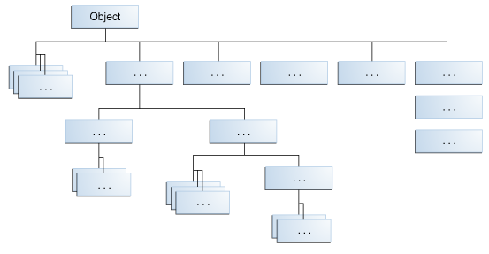
Object Class
If a class does not explicitly extend another class, then it implicitly extends Object directly.
All classes inherit the following methods from the Object class:
  equals()
  toString()
  hashCode()
  You’ll learn more about these methods in the future!
Object is the root of the class hierarchy. Every class extends from Object, either directly or indirectly.

Slide 158
super Keyword
The super keyword is used in a subclass to access fields, methods, and constructors from its superclass.
  The super keyword has similar uses as the this keyword, but it is used in parent-child inheritance relationships.
Common uses:
  Chain to a superclass constructor
  Invoke the superclass implementation of an instance method
  Specify an instance field in the superclass instead of an instance field in the subclass or a local variable with the same name.
    Note: Declaring a field in a subclass with the same name as one in the superclass “hides” the superclass field. BAD PRACTICE!

Slide 159
Constructor Chaining
Use super(...) to invoke a superclass constructor.
Either super(...) or this(...) must be the first line of every constructor in a child class.
  this(...) is okay because it defers the super(...) call to another constructor in the child class.
If you do not explicitly invoke a superclass constructor, Java automatically invokes the no-args super() constructor before running other statements.
  WARNING: If the superclass does not have a no-args constructor, this will result in a compile error!

Slide 160
Practice: Constructor Chaining
public class Person {
public Person() {
System.out.println("Constructing a Person...");
}
}
public class Student extends Person {
public Student() {
System.out.println("Constructing a Student...");
}
public static void main(String[] args) {
Student student = new Student();
}
}
What is the output?
Constructing a Person...
Constructing a Student...

Slide 161
Overriding Methods
A subclass can override methods it inherits from a superclass to provide a more specific implementation of a common behavior.
  The subclass method has an identical method signature to the superclass method.
  Overriding replaces the superclass implementation with the subclass implementation.
Adding the @Override annotation before a method header in the subclass tells the compiler to check if the method properly overrides a superclass method.
  @Override is NOT required to override a method. It is NOT what makes an overriding method.
WARNING: static methods and final methods cannot be overridden.

Slide 162
Overriding vs. Overloading
Method Overriding | Method Overloading
identical method signatures (same name, same parameter lists) | different method signatures (same name, different parameter lists)
can only occur in the subclass of an inheritance relationship | can occur within one class or in an inheritance relationship

Slide 163
Example: Overriding Methods
public class Parent {
public void greet(String name) {
System.out.printf("Parent: Hello %s!\n", name);
}
}
public class Child extends Parent {
public void greet(String name, char punc) { // OVERLOAD
System.out.printf("Hello %s%c\n", name, punc);
}
public void greet(String name) { // OVERRIDE
System.out.printf("Child: Hello %s!\n", name);
}
}

Slide 164
Packages
Recall that packages are used to group classes with related functions.
Examples of packages included with the Java API:
  java.lang // (implicitly imported)
  java.util
You can also create packages to group classes you wrote yourself.
Note: We will not create packages in this course, but you should know how packages relate to visibility modifiers.

Slide 165
Additional Visibility Modifiers
default (no visibility modifier): visible to all classes in the same package
  Also known as package-private.
  Subclasses can only access default visibility fields and methods if the subclass is in the same package as the superclass.
protected: visible to all classes in the same package and all subclasses (in any package)
  Subclasses can always access protected fields and methods.

Slide 166
Visibility Modifiers Table
 | Class | Package | Subclasses | Global
public | ✓ | ✓ | ✓ | ✓
protected | ✓ | ✓ | ✓ | ✗
default | ✓ | ✓ | ✗ | ✗
private | ✓ | ✗ | ✗ | ✗

Slide 167
Practice: Visibility Modifiers
public class Book {
public String title;
protected String author;
private int pageCount;
}
Suppose Book and Textbook are in different packages. Will each of these three lines of code compile?
public class Textbook extends Book {
public static void main(String[] args) {
Textbook myTextbook = new Textbook();
System.out.println(myTextbook.title); // 1.
System.out.println(myTextbook.author); // 2.
System.out.println(myTextbook.pageCount); // 3.
}
}
yes
yes
no

Slide 168
Javadocs
Javadocs are special comments written above a class, field, or method.
  Well-written Javadocs describe functionality and help other developers understand and use your code.
  Javadocs generate neatly-styled documentation, which is part of the contract of methods and classes.
Modules → General Information → Tutorials & Guides → Javadocs.pdf
Tag | Description
@author | Adds the author of a class
@version | Adds a specified version to the class
@param | Adds a parameter with the specified parameter name and a description of the parameter
@return | Adds a description of what the method returns

Slide 169
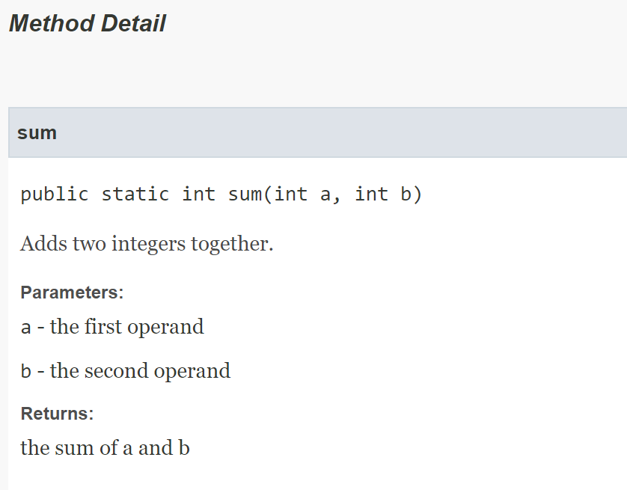
Example: Javadocs
/**
* Adds two integers together.
*
* @param a the first operand
* @param b the second operand
* @return the sum of a and b
*/
public static int sum(int a, int b) {
return a + b;
}
Run the command javadoc fileName.java from the terminal to generate documentation!

Slide 170
Topic Trivia
public class Wallet {
private CreditCard visa;
private int cash;
public Wallet(CreditCard visa) {
this.visa = visa;
this.cash = 0;
}
}
1. Does the Wallet constructor shallow or
deep copy the visa instance field?
2. What occurs in each of the following lines: autoboxing, unboxing, both, or neither?
Double wrapper = new Double(0.0);
double d = wrapper;
Double value = d;
shallow copy
Line 1: neither (Note: this constructor is deprecated.)
Line 2: unboxing
Line 3: autoboxing

Slide 171
Topic Trivia
3. (T/F) All classes extend Object.
4. What is printed when the constructor
Cat() is invoked?
True. All classes extend Object, either directly or indirectly.
public class Animal {
public Animal() {
System.out.println("Something.");
}
}
public class Cat extends Animal {
public Cat() {
System.out.println("Meow.");
}
}
Something.
Meow.

Slide 172
Topic Trivia
5. (T/F) When two methods in the same class have the same method signature, the method is overridden.
6. (T/F) Variables that are declared protected in a superclass can be accessed in a subclass.
False. You cannot have two methods with the same signature within a class. Overriding can only occur between a superclass and a subclass.
True.

Slide 173
Components of a Good Class
Recall that every class extends the Object class. Thus, all classes inherit methods from Object.
  These methods are implemented in Object, but the default implementations are not very useful and must be overridden.
A good Java class should override the following methods:
  equals()
  hashCode()
    Note: You will not be asked to implement hashCode() in this course, but you should be familiar with its method contract.
  toString()

Slide 174
equals()
The default implementation in Object only checks reference equality.
We must override equals() so that it checks object state equality.
equals() Method Contract (from Java API):
  Let x and y be non-null references.
1. Reflexive: x.equals(x) returns true
2. Symmetric: x.equals(y) == y.equals(x)
3. Transitive: if x.equals(y) and y.equals(z), then x.equals(z)
4. Consistent: if no object data is modified, x.equals(y) always returns the same value
5. Comparison with null: x.equals(null) returns false

Slide 175
Example: equals()
Overridden equals()
(written by programmer)
public boolean equals(Object other) {
if (other == null) {
return false;
}
if (!this.getClass().equals(other.getClass())) {
return false;
}
Dog otherDog = (Dog) other;
return this.name.equals(otherDog.name)
&& this.age == otherDog.age;
}
Default equals()
(provided in Object.java)
public boolean equals(Object other) {
return this == other;
}
Not very useful!
This is an equals() implementation that conforms to the method contract in the Java API.

Slide 176
A Closer Look at equals()
public boolean equals(Object other) {
// Check for null and class equality first!
if (other == null) {
return false;
}
if (!this.getClass().equals(other.getClass())) {
return false;
}
// Cast other to the appropriate type.
Dog otherDog = (Dog) other;
// Now, we can compare instance fields!
return this.name.equals(otherDog.name)
&& this.age == otherDog.age;
}
More on casting soon!

Slide 177
hashCode()
The hashCode() method returns an integer representation of an object.
The default implementation in Object can be thought of as some function of the object’s address in memory (although this is not guaranteed).
hashCode() Method Contract (from Java API):
  If an object has not been modified, hashCode() must return the same integer each time.
  If two objects are equal according to equals(), then they must have the same hash code.
  If two objects have the same hash code, they are not necessarily equal!
You will not be asked to implement hashCode() in this course, but you should be familiar with the contract.

Slide 178
Example: hashCode()
public int hashCode() {
int prime = 31;​
return prime + this.name.hashCode();
}
This hash algorithm simply returns 31 plus the hash code of an instance field.
This is a valid implementation because it guarantees that objects that are equal have the same hash code. However, it is not a good implementation because many objects that are not equal will also have the same hash code.
public int hashCode() {
return 0;
}
Is this a valid hash algorithm? Is it a good hash algorithm?

Slide 179
toString()
The default implementation in Object returns a hexadecimal representation of the object’s hash code.
  The default implementation returns something like ClassName@abcd1234.
  It’s not exactly a memory address, but you can think of it like one.
We must override toString() to return a meaningful string representation of the object.
  Should be concise, informative, and easy to read
  Include information about the object’s state

Slide 180
Example: toString()
Returns something like "Dog@71dac704".
Not particularly meaningful.
Default toString()
(provided in Object.java)
public String toString() {
return getClass().getName() + "@" + Integer.toHexString(hashCode());
}
Overridden toString()
(written by programmer)
public String toString() {
return String.format("My name is %s and I am %d years old.", name, age);
}
Much more useful!

Slide 181
Motivation for Abstract Classes
Last week, we designed this superclass to define common features of its subclasses. Remember that classes get more specific and concrete as you go down the hierarchy, and more general and abstract as you go up.
public class Animal {
private String name;
private int age;
public void makeNoise() { }
public void eat(String food) {}
}
How would you implement the makeNoise() method in Animal? How does an Animal make noise? Well, it depends on what kind of animal it is! Our Animal class is too abstract for us to meaningfully define.
???
public class Dog extends Animal {
private String breed;
public void makeNoise() {
System.out.println("woof");
}
public void eat(String food) {
System.out.printf("%s ate %s",
name, food);
}
}
public class Cat extends Animal {
private int livesRemaining;
public void makeNoise() {
System.out.println("meow");
}
public void eat(String food) {
System.out.printf("%s ate %s",
name, food);
}
}

Slide 182
Abstract Classes
The Animal class is so abstract that it doesn’t make sense to instantiate it.
However, the Animal superclass is useful to describe states and behaviors that are common to all its subclasses.
We can declare Animal to be an abstract class!
  The abstract keyword means that the class can never be instantiated, but it can still be extended like a regular class.
  Like a regular class, an abstract class can also have constructors, methods, and instance variables.
  public abstract class Animal {}
Abstract classes can never be instantiated.

Slide 183
Abstract Methods
Abstract classes can contain abstract methods.
  An abstract method has no implementation.
  If a class has an abstract method, then it must be declared abstract, but an abstract class is not required to have abstract methods.
A concrete subclass of an abstract class must provide an implementation for any inherited abstract methods.
public abstract class Animal {
public abstract void makeNoise();
}
makeNoise() is abstract, because the way an animal makes noise depends on the specific kind of animal. This requires the Dog and Cat subclasses to provide an implementation for makeNoise().
Abstract methods do not have method bodies!

Slide 184
Writing an Abstract Class
public abstract class Animal {
protected String name;
protected int age;
public Animal(String name, int age) {
this.name = name;
this.age = age;
}
public abstract void makeNoise(); // Must be overridden!
public void eat(String food) {
System.out.printf("%s ate %s", name, food);
}
}
Remember that abstract classes cannot be instantiated! For example, new Animal("Max", 12); would cause a compile error. It can still be useful to define constructors in an abstract class, because subclasses constructors often chain to superclass constructors to maximize code reuse.

Slide 185
Practice: Abstract Classes
public abstract class Animal {
public abstract void makeNoise();
}
public class Cow extends Animal {
public void makeNoise(String sound) {
System.out.println(sound);
}
}
public class Bird extends Animal {
public void makeNoise() {
System.out.println("chirp");
}
}
Which classes will compile?
1. Animal
2. Cow
3. Bird
4. Ostrich
public class Ostrich extends Bird {
}
compiles
does not compile
compiles
compiles
A subclass can be concrete if it inherits an implementation for an abstract method from intermediate classes in the hierarchy.

Slide 186
Why Abstraction?
Abstraction lets us reuse code and hide complex implementation details.
  An abstract class defines essential characteristics but allows each subclass to fill in the implementation details.
Not every class should be instantiable!
  For example, it does not make sense to instantiate Animal objects, because Animal is too vague to have meaningful specific behaviors.
  Instead, we define an abstract class Animal that requires all animals to have general behaviors.
  Then, we can define concrete subclasses Dog and Cat that support common Animal behaviors but behave in specific ways.

Slide 187
Polymorphism
Polymorphism means “many forms.”
  For example, an instance of Dog is a Dog, but it is also an Animal, since Dog extends Animal.
In object-oriented programming, polymorphism lets us refer to an object as its own type or as any of its supertypes.
We can refer to a Dog as a Dog. Polymorphism means that we can also refer to a Dog as an Animal! The Animal variable can also refer to a Cat, since Cat is a subtype of Animal.
Dog d = new Dog("Bella", 2);
Animal a = new Dog("Cooper", 7);
a = new Cat("Luna", 4);

Slide 188
Static vs. Dynamic Type
Static type: declared type of a reference; determined at compile-time
  The compiler knows only the static type of a reference variable.
  The static type of a variable cannot be changed after declaration.
Dynamic type: actual type of the object the reference points to at run-time
  The compiler does not know the dynamic type of a reference variable.
  The dynamic type of a reference variable can change, since it may be assigned to point to something else.
The dynamic type must always have an “is-a” relationship with the static type.
Animal a = new Dog();
Eagle e = new Bird();
VALID
INVALID

Slide 189
Static vs. Dynamic Type
Animal a = new Dog();
Eagle e = new Bird();
VALID
INVALID
A reference variable must always point to an object that has an “is a” relationship with the static type.
Static type: Animal
Dynamic type: Dog
Name: a
Static type: Eagle
Dynamic type: Bird
Name: e
0x123ABC
0x456DEF
A Dog is always an Animal.
A Bird is not guaranteed to be an Eagle.
Dog
Name: "Max" Age: 8
Bird
Name: "Ori" Age: 1

Slide 190
Example: Polymorphism
Object
- toString()
Animal
- move()
- makeNoise()
- eat(String)
Note: For the following examples, assume that Animal is a regular concrete class.
Dog
- move()
- makeNoise()
- sit()
- toString()
Cat
- move()
- makeNoise()
- scratch()
- toString()

Slide 191
Practice: Static vs. Dynamic Type
Which of the following lines of code will compile?
Object o1 = new Dog();
Object o2 = new Animal();
Animal a1 = new Object();
Animal a2 = new Dog();
Cat a3 = new Cat();
Dog d = new Animal();
Cat c = new Dog();
compiles
compiles
does not compile
compiles
compiles
does not compile
does not compile

Slide 192
Dynamic Binding
What if makeNoise() is defined in Animal and overridden in Dog? Which implementation will actually be invoked?
At compile-time: The compiler determines if we can invoke the method by checking if the method exists in the static type. (Remember that the compiler knows only the static type!)
  The compiler asks: does makeNoise() exist in Animal?
At run-time: The JVM invokes the implementation provided by the dynamic type.
  The JVM invokes the makeNoise() implementation in Dog.
Animal a = new Dog();
a.makeNoise();

Slide 193
Casting
Since the compiler knows only the static type, it only allows us to invoke methods that are available to the static type, even if the dynamic type has additional methods.
We can typecast the Animal reference to obtain a Dog reference.
Not all casts are legal! There are three types of casting: upcasting, downcasting, and sidecasting.
We know that the object is actually a Dog, and a Dog can sit. However, the compiler knows only that the static type is Animal, and an Animal cannot sit.
Animal a = new Dog();
a.sit(); // COMPILE ERROR
Animal a = new Dog();
Dog d = (Dog) a;
d.sit(); // COMPILES!
The static type of d is Dog, so now we can invoke Dog methods! Note that a and d have different static types, but they point to the exact same Dog object.

Slide 194
Types of Casting
Upcasting
Dog d = new Dog();
Animal a = (Animal) d; // always compiles and runs :D
Downcasting
Animal a = new Dog();
Dog d = (Dog) a; // compiles and runs
Cat c = (Cat) a; // compiles but causes ClassCastException
Sidecasting
Dog d = new Dog();
Cat c = (Cat) d; // COMPILE ERROR

Slide 195
Upcasting
Downcasting
Sidecasting
Dog d = new Dog();
Animal a = (Animal) d; // always compiles and runs :D
Animal a = new Dog();
Dog d = (Dog) a; // compiles and runs
Cat c = (Cat) a; // compiles but causes ClassCastException
Dog d = new Dog();
Cat c = (Cat) d; // COMPILE ERROR
Type: Dog
Name: d
At compile-time: The compiler knows that we are attempting to cast from static type Dog to Animal. Since a Dog is always an Animal, this reference is guaranteed to point to an Animal. This will compile.
At run-time: The JVM can safely cast d to an Animal reference. This will run.
0x123ABC
0x123ABC
Type: Animal
Name: a
Dog
Name: "Max" Age: 8

Slide 196
Downcasting
Sidecasting
Animal a = new Dog();
Dog d = (Dog) a; // compiles and runs
Cat c = (Cat) a; // compiles but causes ClassCastException
Dog d = new Dog();
Cat c = (Cat) d; // COMPILE ERROR
Type: Animal
Name: a
Type: Dog
Name: d
Type: Cat
Name: c
0x123ABC
0x123ABC
At compile-time: Similarly, the compiler knows that the Animal might be a Cat. This will compile.
At run-time: The JVM recognizes that the dynamic type of Animal is not a Cat, so the cast cannot be performed. This code will not run.
At compile-time: The compiler knows only that the static type of a is Animal. The Animal might be a Dog, so the compiler allows this to compile.
At run-time: The JVM checks the dynamic type. Since the object is a Dog, this code also runs.
Dog
Name: "Max" Age: 8

Slide 197
Sidecasting
Dog d = new Dog();
Cat c = (Cat) d; // COMPILE ERROR
Type: Dog
Name: d
Type: Cat
Name: c
×
0x123ABC
At compile-time: The compiler checks the static types. A Dog can never be a Cat, so this will never compile (and will never run).
Dog
Name: "Max" Age: 8

Slide 198
Casting and Method Invocation
Method invocation takes precedence over casting.
Animal a = new Dog();
compile error
compiles & runs
int age = (Dog) a.getAge();
int age = ((Dog) a).getAge();
Attempts to cast the result of a.getAge(), an int, to type Dog.
Downcasts a to static type Dog, and then calls getAge() on the Dog reference.

Slide 199
Practice
public class TA extends Teacher {
public void introduce() {
System.out.println("I am a TA.");
}
public void learn() {
System.out.println("I love learning!");
}
}
public abstract class Person {
public abstract void introduce();
}
public class Teacher extends Person {
public void introduce() {
System.out.println("I am a Teacher.");
}
public void teach() {
System.out.println("I love teaching!");
}
}
public class Professor extends Teacher {
public void introduce() {
System.out.println("I am a Professor.");
}
}
Person
Teacher t = new TA();
t.introduce();
Teacher
Does the code compile?
Does the code run?
If so, what will be printed?
Yes, a TA is a Teacher
Yes
"I am a TA."
Professor
TA

Slide 200
Practice
public class TA extends Teacher {
public void introduce() {
System.out.println("I am a TA.");
}
public void learn() {
System.out.println("I love learning!");
}
}
public abstract class Person {
public abstract void introduce();
}
public class Teacher extends Person {
public void introduce() {
System.out.println("I am a Teacher.");
}
public void teach() {
System.out.println("I love teaching!");
}
}
public class Professor extends Teacher {
public void introduce() {
System.out.println("I am a Professor.");
}
}
Person
Person p = new TA();
p.learn();
Teacher
Does the code compile?
Does the code run?
If so, what will be printed?
No, there is no learn() in Person.
No
Professor
TA

Slide 201
Practice
public class TA extends Teacher {
public void introduce() {
System.out.println("I am a TA.");
}
public void learn() {
System.out.println("I love learning!");
}
}
public abstract class Person {
public abstract void introduce();
}
public class Teacher extends Person {
public void introduce() {
System.out.println("I am a Teacher.");
}
public void teach() {
System.out.println("I love teaching!");
}
}
public class Professor extends Teacher {
public void introduce() {
System.out.println("I am a Professor.");
}
}
Person
TA t = new Teacher();
t.introduce();
Teacher
Does the code compile?
Does the code run?
If so, what will be printed?
No, a Teacher is not a TA.
No
Professor
TA

Slide 202
Practice
public class TA extends Teacher {
public void introduce() {
System.out.println("I am a TA.");
}
public void learn() {
System.out.println("I love learning!");
}
}
public abstract class Person {
public abstract void introduce();
}
public class Teacher extends Person {
public void introduce() {
System.out.println("I am a Teacher.");
}
public void teach() {
System.out.println("I love teaching!");
}
}
public class Professor extends Teacher {
public void introduce() {
System.out.println("I am a Professor.");
}
}
Person
Person p = new Person();
p.introduce();
Teacher
Does the code compile?
Does the code run?
If so, what will be printed?
No, Person is abstract and can never be instantiated.
Professor
TA

Slide 203
Practice
public class TA extends Teacher {
public void introduce() {
System.out.println("I am a TA.");
}
public void learn() {
System.out.println("I love learning!");
}
}
public abstract class Person {
public abstract void introduce();
}
public class Teacher extends Person {
public void introduce() {
System.out.println("I am a Teacher.");
}
public void teach() {
System.out.println("I love teaching!");
}
}
public class Professor extends Teacher {
public void introduce() {
System.out.println("I am a Professor.");
}
}
Person
Person p = new Professor();
((Professor) p).teach();
Teacher
Does the code compile?
Does the code run?
If so, what will be printed?
Yes
Yes
"I love teaching!"
Professor
TA

Slide 204
Practice
public class TA extends Teacher {
public void introduce() {
System.out.println("I am a TA.");
}
public void learn() {
System.out.println("I love learning!");
}
}
public abstract class Person {
public abstract void introduce();
}
public class Teacher extends Person {
public void introduce() {
System.out.println("I am a Teacher.");
}
public void teach() {
System.out.println("I love teaching!");
}
}
public class Professor extends Teacher {
public void introduce() {
System.out.println("I am a Professor.");
}
}
Person
TA t = new TA();
((Teacher) t).learn();
Teacher
Does the code compile?
Does the code run?
If so, what will be printed?
No, learn() does not exist in Teacher
No
Professor
TA

Slide 205
Practice
public class TA extends Teacher {
public void introduce() {
System.out.println("I am a TA.");
}
public void learn() {
System.out.println("I love learning!");
}
}
public abstract class Person {
public abstract void introduce();
}
public class Teacher extends Person {
public void introduce() {
System.out.println("I am a Teacher.");
}
public void teach() {
System.out.println("I love teaching!");
}
}
public class Professor extends Teacher {
public void introduce() {
System.out.println("I am a Professor.");
}
}
Person
Teacher t = new Professor();
((TA) t).introduce();
Teacher
Does the code compile?
Does the code run?
If so, what will be printed?
Yes
No, ClassCastException because a Professor is not a TA.
Professor
TA

Slide 206
Practice
public class TA extends Teacher {
public void introduce() {
System.out.println("I am a TA.");
}
public void learn() {
System.out.println("I love learning!");
}
}
public abstract class Person {
public abstract void introduce();
}
public class Teacher extends Person {
public void introduce() {
System.out.println("I am a Teacher.");
}
public void teach() {
System.out.println("I love teaching!");
}
}
public class Professor extends Teacher {
public void introduce() {
System.out.println("I am a Professor.");
}
}
Person
Professor p = new Professor();
((TA) p).introduce();
Teacher
Does the code compile?
Does the code run?
If so, what will be printed?
No, attempted sidecast
No
Professor
TA

Slide 207
Practice
public class TA extends Teacher {
public void introduce() {
System.out.println("I am a TA.");
}
public void learn() {
System.out.println("I love learning!");
}
}
public abstract class Person {
public abstract void introduce();
}
public class Teacher extends Person {
public void introduce() {
System.out.println("I am a Teacher.");
}
public void teach() {
System.out.println("I love teaching!");
}
}
public class Professor extends Teacher {
public void introduce() {
System.out.println("I am a Professor.");
}
}
Person
Object o = new TA();
o.toString();
Teacher
Does the code compile?
Does the code run?
If so, what will be printed?
Yes, a TA is an Object
Yes
toString() from Object is invoked
Professor
TA

Slide 208
Topic Trivia
What are the static and dynamic types of the dog variable?
(T/F) Upcasting will always compile but may not run.
Suppose Dog extends Animal. What type of cast occurs on the second line? Will it compile? Will it run?
Does the JVM invoke the methods of the static type or dynamic type?
static type: Animal
dynamic type: Dog
Animal dog = new Dog();
false, upcasting always compiles and runs
Animal animal = new Dog();
Dog dog = (Dog) animal;
downcast
compiles and runs
dynamic

Slide 209
Motivation for Interfaces
Inheritance allows us to define superclasses to generalize states and behaviors that are common to multiple subclasses.
How might we write a superclass to generalize the common features of these classes?
public class Dog {
public void feed() {
System.out.println("Feeding the dog.");
}
}
public class Fire {
public void feed() {
System.out.println("Feeding the fire.");
}
}

Slide 210
Motivation for Interfaces
public class ????? {
public void feed() {
?????
}
}
public class Dog {
public void feed() {
System.out.println("Feeding the dog.");
}
}
public class Fire {
public void feed() {
System.out.println("Feeding the fire.");
}
}
Remember that a subclass should have an “is a” relationship with its superclass. Other than being feedable, a Dog and a Fire have essentially nothing in common! There is no way to define a superclass with which both subclasses have a logical “is a” relationship.

Slide 211
Interfaces
An interface is similar to an abstract class, but it defines only what something can do, not what it is.
  By convention, interface names often end with –able, because an interface describes what a class must be able to do.
An interface is a collection of abstract methods that define behaviors a class must support. We say that a class implements an interface.
public interface Feedable {
public abstract void feed();
}
public class Dog implements Feedable {
public void feed() {
System.out.println("Feeding the dog.");
}
}
public class Fire implements Feedable {
public void feed() {
System.out.println("Feeding the fire.");
}
}

Slide 212
Interfaces
Recall that multiple inheritance is not allowed in Java. A class can directly extend only one superclass.
However, a class can implement multiple interfaces!
  To implement multiple interfaces, use the implements keyword followed by a comma-separated list of interfaces.
  A class can also simultaneously extend a superclass and implement interfaces.
public class Dog extends Animal implements Walkable, Feedable {
// This class inherits fields and methods from Animal.
// This class must implement all abstract methods in Walkable.
// This class must implement all abstract methods in Feedable.
}

Slide 213
Defining Interfaces
Methods: interfaces can have abstract instance methods, static methods, and default methods
  All methods are implicitly public, so you can omit the public modifier.
  Instance methods are implicitly abstract, so you can omit the abstract keyword.
  Static methods must be defined with the static keyword.
  Default methods must be defined with the default modifier.
Fields: interfaces can only have constants (static final)
  All fields are implicitly public static final, so you can omit these modifiers.
Interfaces CANNOT have instance fields or constructors.

Slide 214
Default Methods
Default methods allow backward compatibility when updating interfaces.
  Implementing classes must override all abstract methods, so adding a new abstract method to an interface would break all existing implementing classes.
  Default methods have implementations, which allows you to add functionalities to an interface without breaking any classes.
    A default method can be overridden in implementing classes.
If a class implements two interfaces that define default methods with the same method signature, you must resolve the conflict by overriding the method.

Slide 215
Example: Interfaces
Fields are implicitly public static final.
public interface Spreadable {
double GRAMS_PER_TBSP = 16.0;
void spread();
default void taste() {
System.out.println("Tasting!");
}
}
public class PeanutButter implements Spreadable {
public void spread() {
System.out.printf("Spreading %.2fg of peanut butter!",
Spreadable.GRAMS_PER_TBSP);
}
}
Methods are public abstract by default.
default methods must have an implementation.

Slide 216
Implementing Interfaces
A concrete class that implements an interface must override all abstract
methods in the interface.
  An abstract class that implements an interface does not have to override abstract methods.
  An interface that extends another interface does not have to override abstract methods.
An interface with exactly one abstract method is called a functional interface.
Interfaces are reference types, so an interface can be used as a static type.
  The dynamic type must be a class that implements the interface.
  Example: Feedable dog = new Dog();

Slide 217
Example
Using an interface as a static type:
Spreadable myJelly = new Jelly();
public interface Eatable {
void eat();
}
public interface Spreadable extends Eatable {
void spread();
}
Spreadable does not have to override eat().
public class Jelly implements Spreadable {
public void eat() {
System.out.println("Eating jelly!");
}
public void spread() {
System.out.println("Spreading jelly!");
}
}
Jelly must provide an implementation for both eat() and spread().

Slide 218
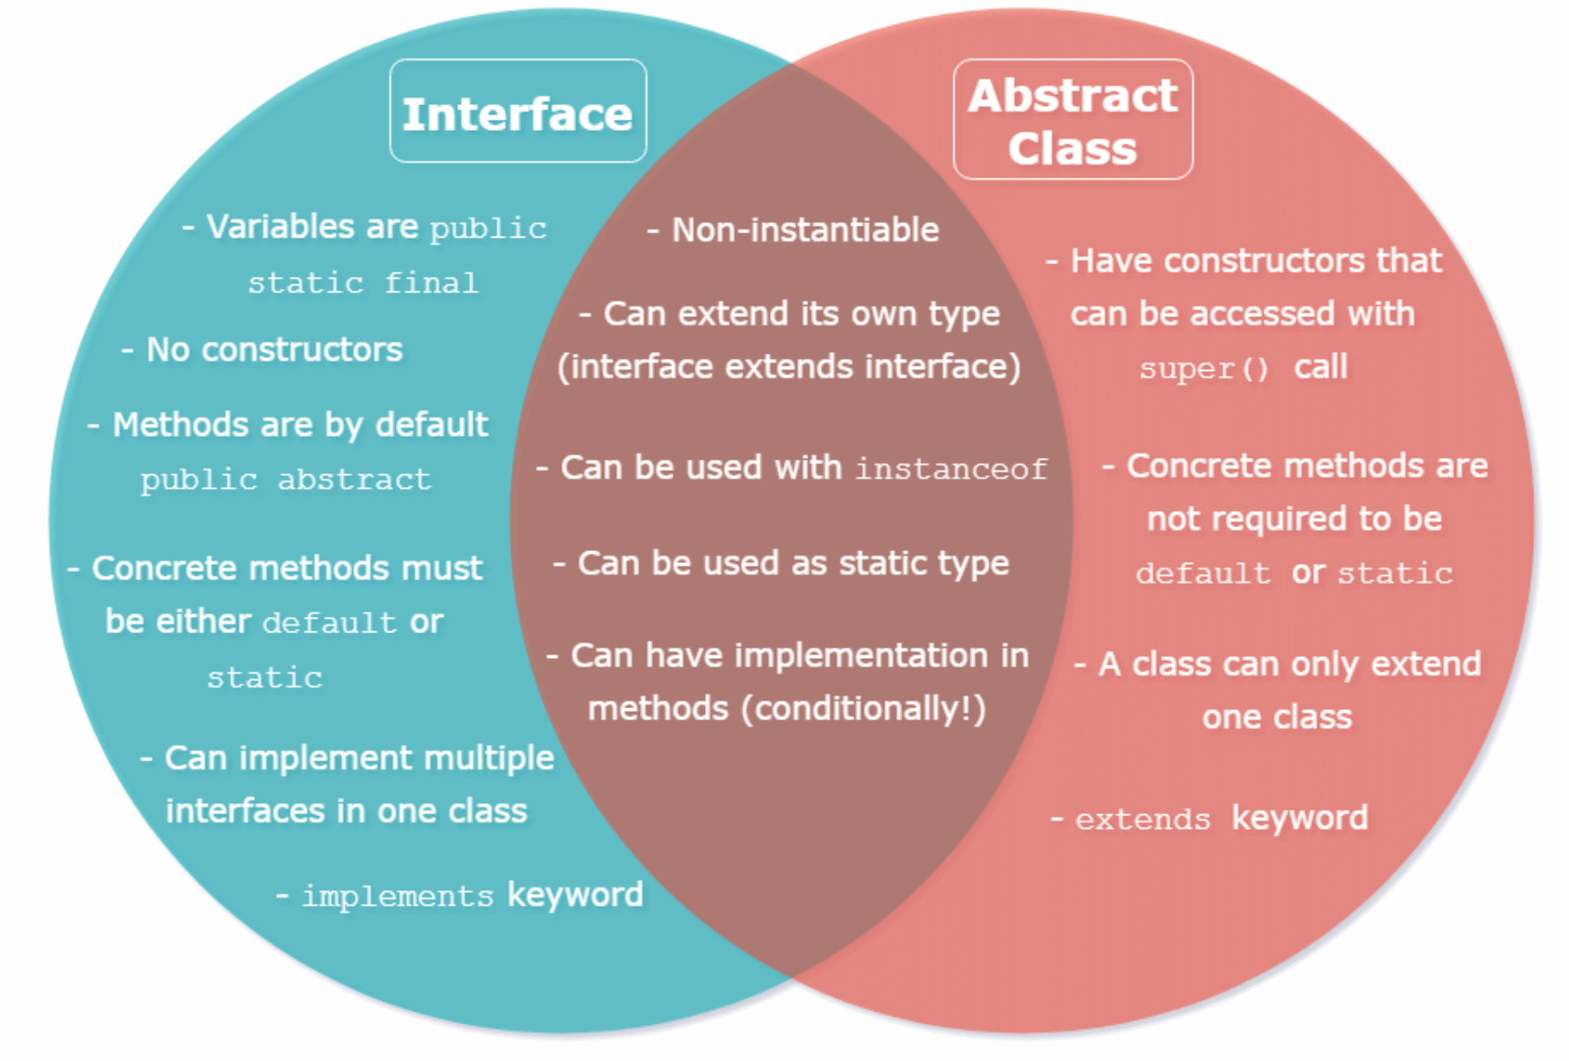
Interfaces vs. Abstract Classes
Describes what something can do
Describes what something is

Slide 219
Comparable
Comparable is a functional interface with one abstract method: compareTo()
Not all classes implement Comparable, so not all objects can be compared using compareTo()!
  Comparable is useful for sorting objects.
  Some examples of Comparable classes: String, wrapper classes
compareTo() Method Contract
Return Value | Meaning
negative integer | a is less than b
0 | a and b are equal
positive integer | a is greater than b
a.compareTo(b)

Slide 220
Example: compareTo()
public class Dog implements Comparable<Dog> {
private int age;
/**
* Compares two Dog objects based on age.
* This Dog is considered greater if its age is larger.
*
* @param other the Dog to be compared
* @return negative, zero, or positive integer if this Dog
* is less than, equal to, or greater than the other Dog
*/
public int compareTo(Dog other) {
if (this.age > other.age) {
return 999; // Note: does not have to be 1
} else if (this.age < other.age) {
return -999; // Note: does not have to be -1
} else {
return 0;
}
}
}
More on this soon!
This implementation satisfies the compareTo() method contract, but how can we make it more concise?

Slide 221
Improved compareTo()
public class Dog implements Comparable<Dog> {
private int age;
/**
* Compares two Dog objects based on age.
* This Dog is considered greater if its age is larger.
*
* @param other the Dog to be compared
* @return negative, zero, or positive integer if this Dog
* is less than, equal to, or greater than the other Dog
*/
public int compareTo(Dog other) {
return this.age - other.age;
}
}

Slide 222
ArrayList Data Structure
An ArrayList is a type of List.
  List: ordered collection of data elements that can be accessed by their index (duplicates are typically allowed)
  Lists are homogenous—all elements must have the same static type.
In an ArrayList, the data is stored in an array. We say that it is a List backed by an array.
Data is stored contiguously in memory. There are no gaps between adjacent elements.
Logical size vs. capacity:
  size: number of elements currently stored in the data structure
  capacity: maximum number of elements that can be stored

Slide 223
Java ArrayList
In Java, ArrayList is a class that implements the List interface.
  You must import java.util.ArrayList to use it.
Elements in an ArrayList are ordered and indexed.
An ArrayList dynamically resizes if we need more capacity.
  As a user, we don’t have to worry about running out of capacity since the implementer (Java) takes care of it! How does this happen behind the scenes?
An ArrayList can only store reference type variables. How can we store primitive data in an ArrayList?
To instantiate an ArrayList, just call one of its constructors!
  ArrayList<String> list = new ArrayList<>();
More on this soon!

Slide 224
Useful ArrayList Methods
Return Type | Method Name
void | add(int index, Object element)
boolean | add(Object e)
Object | remove(int index)
boolean | remove(Object o)
boolean | contains(Object o)
void | clear()
Object | get(int index)
int | size()
Think about how these methods would be implemented behind the scenes! See the ArrayList API for more methods.

Slide 225
ArrayList vs. Arrays
ArrayList | Arrays
Dynamic capacity (resizable) | Fixed capacity
Can only store reference types | Can store primitive and reference types
Homogeneous | Homogeneous
Access elements with .get(int index) | Access elements with []
Access the logical size using size() | Access capacity using the length field
Must import java.util.ArrayList | No import required

Slide 226
Motivation for Generics
Our current definition of ArrayList stores reference variables of type Object.
  Since all classes extend Object, this allows an ArrayList to store any reference type, but it also means mean that a single ArrayList can store variables with any dynamic type.
  Type-safety issues: restricts what methods you can invoke on the elements, and prone to casting errors if you try to cast them
Makeshift solution: create an ArrayList class for each specific type
  IntegerArrayList, StringArrayList, etc.
  This is extremely tedious and results in a lot of code repetition.
Better solution: use generics!
  ArrayList<String> list = new ArrayList<>();

Slide 227
Intro to Generics
Generics allow us to use types as parameters when defining classes and interfaces.
  This allows us to use a single class definition for many different types.
  When using a generic type, you must specify a type argument. The type argument must be a reference type.
Benefits of generic classes:
  detect type-related errors at compile-time rather than runtime
  avoid complicated, risky casting
  allow us to write generic class definitions and algorithms that can work with many types

Slide 228
ArrayList with Generics
ArrayList is a generic class:
  public class ArrayList<E>
  Each element must be of type E.
When instantiating an ArrayList, we pass in a specific reference type to replace the generic type.
  ArrayList<String> list = new ArrayList<String>();
    The compiler can infer the type based on the context, so we can omit the type argument when invoking the constructor.
    ArrayList<String> list = new ArrayList<>();

Slide 229
Comparable with Generics
Comparable is a generic interface:
  public interface Comparable<T>
  The type parameter T defines what type a class can be compared to.
  Allows us to avoid repetitive type checks when writing compareTo() methods.
  compareTo() method signature: compareTo(T o)
public class Student implements Comparable<Student> {
public int compareTo(Student otherStudent) {...}
}

Slide 230
Motivation for Asymptotics
How can we analyze how good an algorithm is? Suppose we have two algorithms that perform the same task. Which one is more efficient?
We can analyze the efficiency of an algorithm by considering time complexity and space complexity.
  Time complexity describes how long the algorithm takes to run.
  Space complexity describes how much memory the algorithm uses.
Algorithm analysis often focuses on time complexity, since the problem of space can be solved by adding more memory in hardware (relatively cheap).
How do we analyze the time complexity of an algorithm?
  We cannot simply measure the time it takes to run. Execution time depends on too many variables—hardware, concurrent tasks, inputs, etc.

Slide 231
Asymptotics
Asymptotics (asymptotic analysis) allows us to measure the efficiency of an algorithm independent of a particular computer or specific set of inputs.
Instead of measuring execution time, we establish an upper bound for how quickly the number of operations grows as the input size grows.
Example: Consider an algorithm that takes in an array of length and multiplies each element by ten.
  If the length of the input array doubles, the number of operations will double. Since the number of operations grows proportionally to the input size, we say that this algorithm has a linear growth rate.
  In Big- notation, this algorithm is . We say that it is on the order of .

Slide 232
Big-
Big- notation allows us to ignore non-dominating terms and multiplicative constants.
  Non-dominating terms become insignificant as . Remember that we are concerned about the asymptotic behavior of the algorithm as the input size increases.
  Multiplicative constants have no impact on the order of the growth rate.
  Example:
To determine the Big- of an algorithm, express the number of operations performed as a function of the input size . Then, simply drop any multiplicative constants and non-dominating terms.

Slide 233
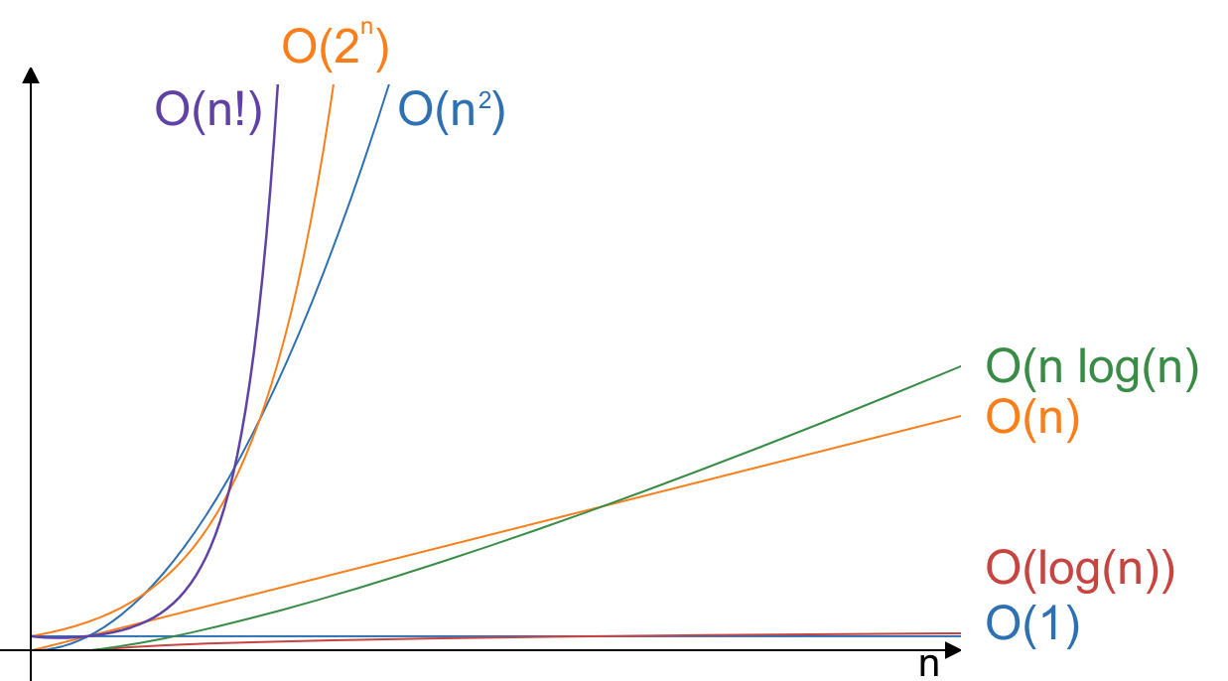
Growth Functions

Slide 234
Example: Big- of Linear Search
/**
* Returns the index of the element in the array,
* or -1 if the element is not in the array.
*
* @param arr array to search in
* @param key element to search for
* @return index of element in array, or -1 if not found
*/
public int linearSearch(int[] arr, int key) {
for (int i = 0; i < arr.length; ++i) {
if (arr[i] == key) {
return i;
}
}
return -1;
}

Slide 235
Example: Big- of Linear Search
Let’s perform complexity analysis on this algorithm!
What is the best case?
  What is the best-case complexity?
What is the worst case?
  What is the worst-case complexity?
Note: We generally care more about worst-case analysis, since it allows us to establish an upper bound for the complexity of an algorithm.
What is the Big- time complexity of linear search?
key is the first element in arr
, only one comparison to make
key is the last element, or key is not in arr
, must check every element

Slide 236
Practice: Big-
for (int i = n; i >= 0; i--) {
System.out.print("*");
}
The loop iterates times. Note that .

Slide 237
Practice: Big-
for (int i = 1; i < n; i *= 2) {
System.out.print("*");
}
Each iteration, i is multiplied by 2. This means that if the input size were to double, only one more * is printed.
In other words, if grows linearly, the number of * printed grows logarithmically.
Thus, the loop iterates times.
This is especially amazing if is large!

Slide 238
Practice: Big-
for (int i = 0; i < n; i++) {
for (int j = 0; j < n; j++) {
System.out.print("*");
}
}
The outer loop iterates times. For each iteration of the outer loop, the inner loop iterates times. Thus, there are total iterations.
If you double the input size, what happens to the number of iterations?

Slide 239
Practice: Big-
for (int i = 0; i < n; i++) {
for (int j = 0; j < 1000; j++) {
System.out.print("*");
}
}
The outer loop iterates times. For each iteration of the outer loop, the inner loop iterates times. Thus, there are total iterations.
Note that , since we ignore multiplicative constants in Big- notation.

Slide 240
Linear Search
Key: 61
Input:
9 | 77 | 24 | 14 | 31 | 61 | 5 | 13 | 55
9
77
24
14
31
61
arr[i] == 61?

Slide 241
Linear Search
Iterate through the list sequentially and compare the key to each element in the list.
Consider the worst case for a linear search: the key is the last element in the list, or the key is not in the list at all.
  What is the worst-case time complexity?
What is the time complexity of linear search?
  If the input size increases by , we must perform more comparisons.
  If the input list has one billion elements, linear search will perform one billion comparisons in the worst case!
comparisons
Notes:
Josh

Slide 242
Binary Search
If the list is sorted, we can do much better than !
Key: 61
>
==
<
Input:
10 | 19 | 23 | 25 | 36 | 61 | 79 | 81 | 99
10
19
23
25
36
61
79
81
99
Is 61 greater than, less than, or equal to this element?

Slide 243
Binary Search
Algorithm:
  Find the middle element in the list.
  Compare the key to the middle element:
    If the key equals the middle element, we found the target!
    If the key is less than the middle element, then we only need to continue searching in the first half.
    If the key is greater than the middle element, then we only need to continue searching in the second half.
  Repeat steps 1 and 2 until the key is found, or there are no more elements to compare.

Slide 244
Binary Search
With each comparison, we can eliminate at least half of the remaining elements!
What is the time complexity of binary search?
  If the input size increases by , we only need to perform more comparisons.
  If the input array has one billion elements, binary search will perform at most 30 comparisons!

Slide 245
Sorting
Binary search can find an element much more efficiently than linear search. However, the binary search algorithm can only be used on sorted data.
How can we write an algorithm to sort data?
We will cover three iterative sorting algorithms:
  Selection sort
  Insertion sort
  Bubble sort

Slide 246
Selection Sort
swap
swap
swap
swap
swap
swap
15 | 20 | 18 | 25 | 22 | 34 | 13
13
20
18
34
34
15
18
25
20
15
15
15
25
22
13
34
18
22
25
22
20
20
25
Sorted list

Slide 247
Selection Sort
Algorithm: Select the smallest element and swap it with the first element. Then, select the smallest remaining element and swap it with the second element. Continue until the list is sorted.
  After iterations, the smallest elements have been swapped into their final positions.
3 | 4 | 8 | 5 | 6
3 | 4 | 5 | 8 | 6
sorted
unsorted
sorted
unsorted

Slide 248
Selection Sort Complexity Analysis
What is the time complexity of selection sort?
  We must iterate times to swap elements into their correct positions. In each iteration, we must find the minimum of the remaining elements, which is on the order of .
There is no way to optimize selection sort.
  Selection sort always performs on the order of .

Slide 249
Insertion Sort
insert
insert
insert
insert
insert
insert
insert
1 | 2 | 3 | 4 | 5 | 7 | 9 | 6
1 | 2 | 3 | 4 | 5 | 6 | 7 | 9
2 | 3 | 4 | 7 | 9 | 1 | 5 | 6
2 | 3 | 4 | 7 | 9 | 1 | 5 | 6
1 | 2 | 3 | 4 | 7 | 9 | 5 | 6
3 | 4 | 2 | 7 | 9 | 1 | 5 | 6
2 | 3 | 4 | 7 | 9 | 1 | 5 | 6
4 | 3 | 2 | 7 | 9 | 1 | 5 | 6
4 | 3 | 2 | 7 | 9 | 1 | 5 | 6
4 | 3 | 2 | 7 | 9 | 1 | 5 | 6

Slide 250
Insertion Sort
Algorithm: Insert the first element in the unsorted sublist into its correct position in the sorted sublist. Continue until the list is sorted.
  After iterations, the first elements are sorted relative to each other. However, they are not necessarily in their final positions!
4 | 6 | 8 | 5 | 3
4 | 5 | 6 | 8 | 3
sorted
unsorted
sorted
unsorted

Slide 251
Insertion Sort Complexity Analysis
What is the time complexity of insertion sort?
  We must iterate times to insert elements into their correct positions. In each iteration, we must compare with elements in the sorted sublist to determine the correct position, which is on the order of .
What is the best case for insertion sort?
  What is the best-case time complexity?
Optimization: If the element to insert is greater than or equal to the element on the left, then it is already in relatively sorted order! We do not need to perform any further comparisons, and we do not need to swap any elements.
  If the list is already sorted, insertion sort performs only one pass through the list!
List is already sorted

Slide 252
Bubble Sort
1st pass
2nd pass
3rd pass
4th pass
5 | 3 | 2 | 6 | 1
3 | 2 | 5 | 1 | 6
2 | 3 | 1 | 5 | 6
2 | 1 | 3 | 5 | 6
5 | 3 | 2 | 6 | 1
3 | 2 | 5 | 1 | 6
2 | 3 | 1 | 5 | 6
2 | 1 | 3 | 5 | 6
3 | 5 | 2 | 6 | 1
2 | 3 | 5 | 1 | 6
2 | 3 | 1 | 5 | 6
1 | 2 | 3 | 5 | 6
3 | 2 | 5 | 6 | 1
2 | 3 | 5 | 1 | 6
2 | 1 | 3 | 5 | 6
3 | 2 | 5 | 6 | 1
2 | 3 | 1 | 5 | 6
3 | 2 | 5 | 1 | 6

Slide 253
Bubble Sort
Algorithm: On each pass, neighboring pairs are compared. If a pair is in the wrong order, the values are swapped. Continue until the list is sorted.
  After iterations, the largest elements have been “bubbled” to their final positions.
  At the end of each pass, the largest element in the unsorted sublist has been bubbled to the end of the unsorted sublist. This element can now be appended to the front of the sorted sublist.
5 | 3 | 4 | 6 | 8
3 | 4 | 5 | 6 | 8
unsorted
sorted
unsorted
sorted

Slide 254
Bubble Sort Complexity Analysis
What is the time complexity of bubble sort?
  We must iterate times to bubble elements into their correct positions. In each iteration, we must compare successive pairs in the unsorted sublist, which is on the order of .
What is the best case for bubble sort?
  What is the best-case time complexity?
Optimization: If no swaps are made in a pass, then we know that the list is already sorted, and we can terminate the algorithm early.
  If the list is already sorted, bubble sort performs only one pass through the list!
List is already sorted

Slide 255
Recursion: Factorial
How would we write a method to compute the factorial of a number?
Factorial can be defined iteratively:
It can also be defined recursively:
Note: It is much simpler and more efficient to calculate factorial iteratively, but it is useful to consider how to do it with recursion for the sake of learning how to think recursively.

Slide 256
Recursion: Factorial
public static void main(String[] args) {
int x = 4;
System.out.println(factorial(x));
}
public static int factorial(int n) {
if (n == 0) {
return 1;
}
return n * factorial(n – 1);
}
n = 4
factorial(4)
main()
Method Call Stack

Slide 257
Recursion: Factorial
public static void main(String[] args) {
int x = 4;
System.out.println(factorial(x));
}
public static int factorial(int n) {
if (n == 0) {
return 1;
}
return n * factorial(n – 1);
}
public static int factorial(int n) {
if (n == 0) {
return 1;
}
return n * factorial(n – 1);
}
n = 4
n = 3
factorial(3)
factorial(4)
main()
Method Call Stack

Slide 258
Recursion: Factorial
public static void main(String[] args) {
int x = 4;
System.out.println(factorial(x));
}
public static int factorial(int n) {
if (n == 0) {
return 1;
}
return n * factorial(n – 1);
}
public static int factorial(int n) {
if (n == 0) {
return 1;
}
return n * factorial(n – 1);
}
n = 4
public static int factorial(int n) {
if (n == 0) {
return 1;
}
return n * factorial(n – 1);
}
n = 3
n = 2
factorial(2)
factorial(3)
factorial(4)
main()
Method Call Stack

Slide 259
Recursion: Factorial
public static void main(String[] args) {
int x = 4;
System.out.println(factorial(x));
}
public static int factorial(int n) {
if (n == 0) {
return 1;
}
return n * factorial(n – 1);
}
public static int factorial(int n) {
if (n == 0) {
return 1;
}
return n * factorial(n – 1);
}
n = 4
public static int factorial(int n) {
if (n == 0) {
return 1;
}
return n * factorial(n – 1);
}
n = 3
public static int factorial(int n) {
if (n == 0) {
return 1;
}
return n * factorial(n – 1);
}
n = 2
n = 1
factorial(1)
factorial(2)
factorial(3)
factorial(4)
main()
Method Call Stack

Slide 260
Recursion: Factorial
public static void main(String[] args) {
int x = 4;
System.out.println(factorial(x));
}
public static int factorial(int n) {
if (n == 0) {
return 1;
}
return n * factorial(n – 1);
}
public static int factorial(int n) {
if (n == 0) {
return 1;
}
return n * factorial(n – 1);
}
n = 4
public static int factorial(int n) {
if (n == 0) {
return 1;
}
return n * factorial(n – 1);
}
n = 3
public static int factorial(int n) {
if (n == 0) {
return 1;
}
return n * factorial(n – 1);
}
n = 2
factorial(0)
public static int factorial(int n) {
if (n == 0) {
return 1;
}
return n * factorial(n – 1);
}
n = 1
n = 0
factorial(1)
factorial(2)
factorial(3)
factorial(4)
main()
Method Call Stack

Slide 261
Recursion: Factorial
public static void main(String[] args) {
int x = 4;
System.out.println(factorial(x));
}
public static int factorial(int n) {
if (n == 0) {
return 1;
}
return n * factorial(n – 1);
}
public static int factorial(int n) {
if (n == 0) {
return 1;
}
return n * factorial(n – 1);
}
n = 4
public static int factorial(int n) {
if (n == 0) {
return 1;
}
return n * factorial(n – 1);
}
n = 3
public static int factorial(int n) {
if (n == 0) {
return 1;
}
return n * factorial(n – 1);
}
n = 2
factorial(0)
public static int factorial(int n) {
if (n == 0) {
return 1;
}
return n * factorial(n – 1);
}
n = 1
n = 0
factorial(1)
factorial(2)
factorial(3)
factorial(4)
main()
Method Call Stack

Slide 262
Recursion: Factorial
public static void main(String[] args) {
int x = 4;
System.out.println(factorial(x));
}
public static int factorial(int n) {
if (n == 0) {
return 1;
}
return n * factorial(n – 1);
}
public static int factorial(int n) {
if (n == 0) {
return 1;
}
return n * factorial(n – 1);
}
n = 4
public static int factorial(int n) {
if (n == 0) {
return 1;
}
return n * factorial(n – 1);
}
n = 3
public static int factorial(int n) {
if (n == 0) {
return 1;
}
return n * factorial(n – 1);
}
n = 2
n = 1
factorial(1)
factorial(2)
1
factorial(3)
factorial(4)
main()
Method Call Stack

Slide 263
Recursion: Factorial
public static void main(String[] args) {
int x = 4;
System.out.println(factorial(x));
}
public static int factorial(int n) {
if (n == 0) {
return 1;
}
return n * factorial(n – 1);
}
public static int factorial(int n) {
if (n == 0) {
return 1;
}
return n * factorial(n – 1);
}
n = 4
public static int factorial(int n) {
if (n == 0) {
return 1;
}
return n * factorial(n – 1);
}
n = 3
n = 2
1
factorial(2)
factorial(3)
factorial(4)
main()
Method Call Stack

Slide 264
Recursion: Factorial
public static void main(String[] args) {
int x = 4;
System.out.println(factorial(x));
}
public static int factorial(int n) {
if (n == 0) {
return 1;
}
return n * factorial(n – 1);
}
public static int factorial(int n) {
if (n == 0) {
return 1;
}
return n * factorial(n – 1);
}
n = 4
n = 3
2
factorial(3)
factorial(4)
main()
Method Call Stack

Slide 265
Recursion: Factorial
public static void main(String[] args) {
int x = 4;
System.out.println(factorial(x));
}
public static int factorial(int n) {
if (n == 0) {
return 1;
}
return n * factorial(n – 1);
}
n = 4
6
factorial(4)
main()
Method Call Stack

Slide 266
Recursion: Factorial
public static void main(String[] args) {
int x = 4;
System.out.println(factorial(x));
}
24
main()
Method Call Stack

Slide 267
Recursion: Factorial
Definition.
/**
* Recursive factorial function.
*
* @param n number to calculate the factorial of
*/
public static int factorial(int n) {
// Base case: n = 0
if (n == 0) {
return 1;
}
// Recursive call: factorial(n - 1)
// Approach base case: n eventually decreases to 0
return n * factorial(n – 1);
}
Three requirements of a recursive method:
  Base case
  Recursive call
  Approaching a base case

Slide 268
Recursion
The fundamental idea of recursion is to solve a problem by breaking it down into smaller problems that can be solved with the same algorithm.
Three requirements for a recursive method:
  Base case(s): smallest problem; typically has a trivial solution
    no recursive call in base case terminates recursion
  Recursive call(s): solve a smaller subproblem by invoking the same method with different inputs
  Approaching a base case: decrease the problem size
WARNING: Recursion does not proceed infinitely! If you fail to define a base case or fail to approach the base case, method calls will be pushed onto the stack until a StackOverflowError occurs and the program terminates.
Notes:
Josh

Slide 269
Merge Sort
Merge sort is the most efficient sorting algorithm we discuss in this course!
Algorithm: Divide the list into two halves and apply the merge sort algorithm on each half recursively. After both halves are sorted, merge them together.
Merge sort is an inherently recursive algorithm!
  Base cases: a list of size 0 or 1 is already sorted
  Recursive calls: split the list into two halves, and run the merge sort algorithm on each half
    The two sorted halves can be merged back together in time.
  Approaching the base case: repeatedly splitting the list in half will eventually produce lists of size 0 or 1

Slide 270
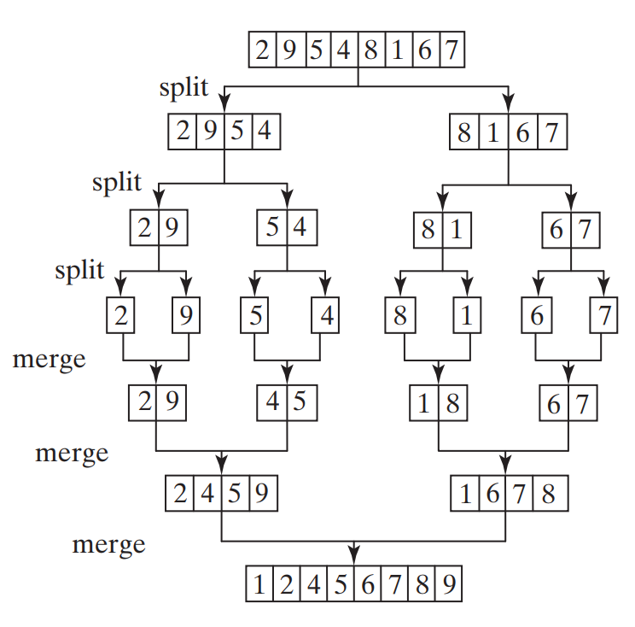
Merge Sort
elements must be visited per split/merge
splits
merges
File: Liang, Introduction to Java Programming

Slide 271
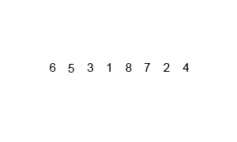
Merge Sort Animation
File: Wikipedia
Notes:
/Josh

Slide 272
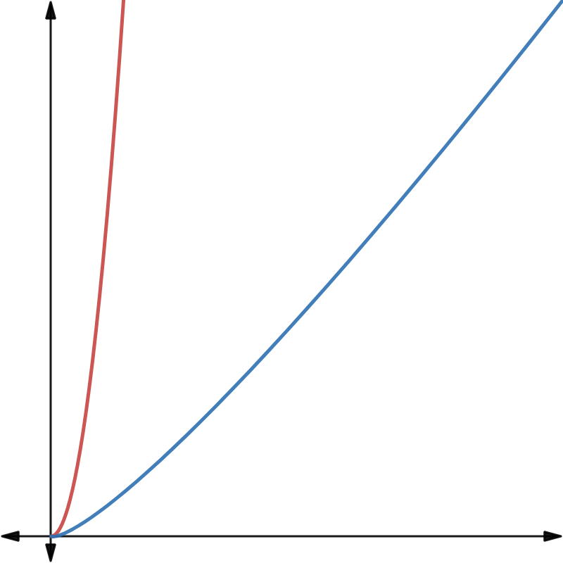
vs.
(selection sort, insertion sort, bubble sort)
(merge sort)

Slide 273
Exceptions
Exceptions are events that occur during runtime that disrupt the normal flow of instructions.
  If an exception is not handled, the program will terminate abruptly. We want to handle exceptions so that the program can continue running or terminate gracefully.
  Examples: NullPointerException, ArithmeticException, IndexOutOfBoundsException
“Throwing an exception”: When the JVM detects an exceptional event, such as an instruction that is impossible to execute, the method creates an Exception object, which contains information about the event that occurred. The Exception is handed off to the JVM to be handled.

Slide 274
Exceptions
public static void main(String[] args) {
int x = 4;
System.out.println(methodOne(x));
}
main()
Method Call Stack

Slide 275
Exceptions
public static void main(String[] args) {
int x = 4;
System.out.println(methodOne(x));
}
public int methodOne(int x) {
x += 5;
return methodTwo(x);
}
main()
Method Call Stack

Slide 276
Exceptions
public static void main(String[] args) {
int x = 4;
System.out.println(methodOne(x));
}
public int methodOne(int x) {
x += 5;
return methodTwo(x);
}
methodOne(4)
main()
Method Call Stack

Slide 277
Exceptions
public static void main(String[] args) {
int x = 4;
System.out.println(methodOne(x));
}
public int methodOne(int x) {
x += 5;
return methodTwo(x);
}
public int methodTwo(int len) {
int[] arr = new int[len];
// ... <code that populates arr with values>
int sum = 0;
for (int i = len; i >= 0; --i) {
sum += arr[i];
}
return sum;
}
methodOne(4)
main()
Method Call Stack

Slide 278
Exceptions
public static void main(String[] args) {
int x = 4;
System.out.println(methodOne(x));
}
public int methodOne(int x) {
x += 5;
return methodTwo(x);
}
public int methodTwo(int len) {
int[] arr = new int[len];
// ... <code that populates arr with values>
int sum = 0;
for (int i = len; i >= 0; --i) {
sum += arr[i];
}
return sum;
}
methodTwo(9)
methodOne(4)
main()
Method Call Stack

Slide 279
Exceptions
public static void main(String[] args) {
int x = 4;
System.out.println(methodOne(x));
}
public int methodOne(int args) {
x += 5;
return methodTwo(x);
}
public int methodTwo(int len) {
int[] arr = new int[len];
// ... <code that populates arr with values>
int sum = 0;
for (int i = len; i >= 0; --i) {
sum += arr[i];
}
return sum;
}
methodTwo(9)
methodOne(4)
main()
Method Call Stack

Slide 280
Exceptions
public static void main(String[] args) {
int x = 4;
System.out.println(methodOne(x));
}
public int methodOne(int args) {
x += 5;
return methodTwo(x);
}
public int methodTwo(int len) {
int[] arr = new int[len];
// ... <code that populates arr with values>
int sum = 0;
for (int i = len; i >= 0; --i) {
sum += arr[i];
}
return sum;
}
methodTwo(9)
methodOne(4)
main()
Method Call Stack

Slide 281
Exceptions
public static void main(String[] args) {
int x = 4;
System.out.println(methodOne(x));
}
public int methodOne(int args) {
x += 5;
return methodTwo(x);
}
public int methodTwo(int len) {
int[] arr = new int[len];
// ... <code that populates arr with values>
int sum = 0;
for (int i = len; i >= 0; --i) {
sum += arr[i];
}
return sum;
}
methodTwo(9)
methodOne(4)
main()
Method Call Stack

Slide 282
Exceptions
public static void main(String[] args) {
int x = 4;
System.out.println(methodOne(x));
}
public int methodOne(int args) {
x += 5;
return methodTwo(x);
}
public int methodTwo(int len) {
int[] arr = new int[len];
// ... <code that populates arr with values>
int sum = 0;
for (int i = len; i >= 0; --i) {
sum += arr[i];
}
return sum;
}
methodTwo(9)
methodOne(4)
main()
Method Call Stack

Slide 283
Exceptions
public static void main(String[] args) {
int x = 4;
System.out.println(methodOne(x));
}
public int methodOne(int args) {
x += 5;
return methodTwo(x);
}
public int methodTwo(int len) {
int[] arr = new int[len];
// ... <code that populates arr with values>
int sum = 0;
for (int i = len; i >= 0; --i) {
sum += arr[i];
}
return sum;
}
IndexOutOfBoundsException!
methodTwo(9)
methodOne(4)
main()
Method Call Stack

Slide 284
Exceptions
public static void main(String[] args) {
int x = 4;
System.out.println(methodOne(x));
}
public int methodOne(int args) {
x += 5;
return methodTwo(x);
}
public int methodTwo(int len) {
int[] arr = new int[len];
// ... <code that populates arr with values>
int sum = 0;
for (int i = len; i >= 0; --i) {
sum += arr[i];
}
return sum;
}
IndexOutOfBoundsException!
methodOne(4)
main()
Method Call Stack

Slide 285
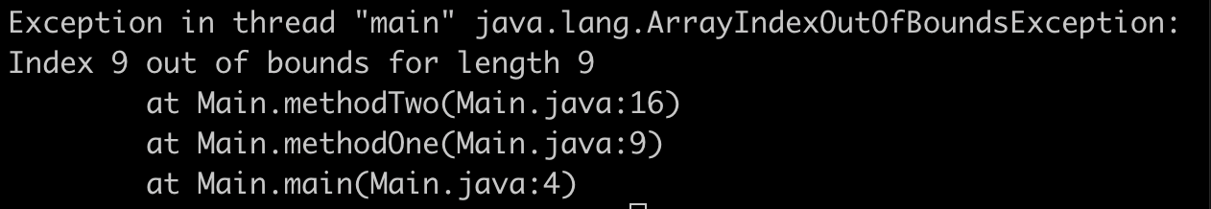
Exceptions
public static void main(String[] args) {
int x = 4;
System.out.println(methodOne(x));
}
IndexOutOfBoundsException!
public int methodOne(int args) {
x += 5;
return methodTwo(x);
}
The JVM prints the method call stack (stack trace) when the main method throws an exception!
main()
Method Call Stack

Slide 286
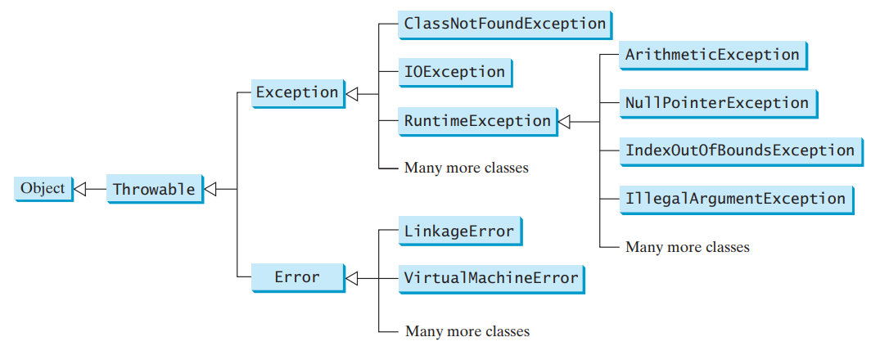
Exceptions
unchecked
checked
Checked exceptions must be caught or acknowledged.
Unchecked exceptions do not have to be caught or acknowledged.

Slide 287
Exception Responses
Do nothing and allow the program to crash.
  WARNING: This is not allowed for checked exceptions!
Handle the exception immediately with try and catch.
  Wrap the potentially problematic code in a try block.
  Write a catch block to catch the exception.
Allow the exception to propagate to another method.
  Acknowledge that the method may cause an exception by declaring the exception in a throws clause in the method header.
  Delegates exception handling to the caller of the method.

Slide 288
try Statement
try block: code that we wish to execute but potentially throws an exception
catch block: code to execute to handle an exception, if an exception is thrown and caught
  You can include multiple catch blocks if the code may throw multiple types of exceptions.
  You must put more specific exceptions before less specific exceptions.
finally block: always executes, whether an exception is thrown or not
  The finally block always executes, even if an exception is thrown but not caught, or if the catch block throws an exception.

Slide 289
Example: try Statement
public static void main(String[] args) {
try {
System.out.println(4 / 0);
} catch (ArithmeticException e) {
System.out.print("ArithmeticException caught! ");
} catch (Exception e) {
System.out.print("Generic exception caught! ");
} finally {
System.out.print("Done! ");
}
}
// prints "ArithmeticException caught! Done!"

Slide 290
Exception Propagating
A method can either handle an exception using try-catch, or it can delegate the responsibility of handling the exception to another method.
If a method does not handle the exception, then the exception propagates to the next method on the call stack, i.e., the method that invoked this method.
  If the main method throws an exception, then the JVM will handle the exception using its default exception handler. The program terminates, and the stack trace is printed to the console.
Checked exceptions must be declared in the throws clause of the method header if they are not handled within the method!
  public void goShopping() throws NoMoneyException {...}

Slide 291
Throwing Exceptions
If a method detects exceptional behavior, it can create an instance of the appropriate exception type and throw it using the throw keyword.
public static void main(String[] args) throws Exception {
int n = 2;
if (n == 2) {
throw new Exception("Something went wrong");
} else {
System.out.println(2);
}
}
Output: Exception in thread "main" java.lang.Exception: Something went wrong
at Test.main(Test.java:5)

Slide 292
vs.
Checked
Unchecked
Not a subtype of RuntimeException
Must be handled using a try-catch statement or acknowledged by declaring it in the throws clause!
  Otherwise, your code will not compile.
Typically, a programmer can reasonably be expected to be able to anticipate and recover from checked exceptions.
May be caught by the JVM.
Extends RuntimeException
Does not have to be caught or acknowledged
Typically caused by programming bugs, such as logic errors or improper use of API
Typically, a programmer cannot reasonably be expected to anticipate or recover from unchecked exceptions.

Slide 293
File I/O
File I/O refers to file input and output, i.e., reading from and writing to files.
Most file I/O classes must be imported from the java.io package.

Slide 294
File Class
import java.io.File;
A File object is an abstract representation of a file or directory pathname.
  A File does not represent the actual file on disk or its contents!
To create a File object, invoke its constructor and provide a pathname.
  File myFile = new File("C:\\example.txt");
  The pathname can be an absolute path or a relative path (relative to the location of the .java file).
Commonly used methods: exists(), isFile(), isDirectory(), canRead(), canWrite(), getAbsolutePath()
  Refer to the API for more methods.

Slide 295
Input
Reading from a file is very similar to reading from the console! We use Scanner to read from files.
  Instead of new Scanner(System.in), pass a File object to the constructor.
The Scanner(File source) constructor throws a FileNotFoundException if the source cannot be found or if the file cannot be read.
import java.io.File;
import java.util.Scanner;
// ...
File file = new File("input.txt");
Scanner scan = new Scanner(file);
scan.nextInt();

Slide 296
Output
Writing to files is very similar to writing to the console! To write to files, use a PrintWriter object.
  PrintWriter has familiar methods: print(), printf(), println()
To instantiate a PrintWriter, use a constructor: PrintWriter(File file) or PrintWriter(String fileName)
  If a file with the file name already exists, it will be overwritten when the PrintWriter is constructed.
  If a file with the file name does not exist, the PrintWriter will attempt to create the file.
  Constructors throw a FileNotFoundException if the file is not writable or a new file cannot be created.

Slide 297
Output
When we write to a file using PrintWriter, the data is first sent to a buffer.
  It is inefficient to always immediately flush to the file, so the buffer waits for more data before writing to the file.
flush(): pushes the buffer into the file, but does not close the stream
close(): flushes the buffer, closes the stream, and releases system resources
  You cannot write to the file after the PrintWriter is closed.
  WARNING: Always close a PrintWriter when you are done using it! Otherwise, the data may not be written to the file, and resources will not be released.

Slide 298
Example: Output
import java.io.File;
import java.io.FileNotFoundException;
import java.io.PrintWriter;
public class Main {
public static void main(String[] args)
throws FileNotFoundException {
PrintWriter writer = new PrintWriter(new File("output.txt"));
writer.println("Hello there!");
writer.close();
}
}

Slide 299
File I/O Exceptions
File I/O exceptions are checked exceptions in the java.io package.
FileNotFoundException:
  Occurs when the program attempts to access or use a file that does not exist.
  May be thrown when a Scanner cannot find the file to read from.
  May be thrown when a PrintWriter cannot write to the file, or the file does not exist and the PrintWriter cannot create the file.
IOException: general I/O exceptions
  Note: FileNotFoundException extends IOException

Slide 300
Example: FileNotFoundException
File file = new File("winstreak.txt");
Scanner scan = new Scanner(file);
int wins = scan.nextInt();
System.out.printf("We've won %d games in a row!\n", wins);
Assume winstreak.txt does not exist. Which line will throw a FileNotFoundException?
What options do we have to handle this exception?
Line 2
1. Wrap this block of code inside a try block and catch the FileNotFoundException with a catch block.
2. Allow the exception to propagate to another by declaring this method throws FileNotFoundException.

Slide 301
Topic Trivia
1. What is the time complexity of a method that sorts an array using selection sort and then searches it using binary search?
2. What is the big- of merge sort?
3. (T/F) The throws clause is required on any method which throws (or could throw) an exception.
4. All exceptions must directly extend Exception.
False
False

Slide 302
Topic Trivia
5. What exception will each segment of code throw? Are they checked or unchecked exceptions?
A. System.out.println(4 / 0);
B. String hello = null;
System.out.println(hello.toUpperCase());
C. import java.io.File;
import java.util.Scanner;
// ...
Scanner s = new Scanner(new File("/does/not/exist"));
ArithmeticException – unchecked
NullPointerException – unchecked
FileNotFoundException – checked

Slide 303
Motivation for Generics
Imagine that generics have not yet been introduced to Java. (Generics were added in Java 5.)
ArrayList is not parameterized and can only store Object references.
  Conveniently, this means that we can store any object, since all classes extend from the Object class.
However, this is not type-safe, because elements in the same ArrayList may have different, unrelated dynamic types.
  Forces us to make repetitive and risky downcasts when using the elements in an ArrayList.
  Increases the likelihood of casting errors that cannot be detected at compile-time and are difficult to find and resolve at runtime.

Slide 304
Motivation for Generics
ArrayList list = new ArrayList();
list.add("Hello");
list.add(1);
list.add(1.2);
String str1 = list.get(0); // does not compile
Integer num1 = list.get(1); // does not compile
Double num2 = list.get(2); // does not compile
String str2 = (String) list.get(0); // compiles and runs
Integer num3 = (Integer) list.get(1); // compiles and runs
Double num4 = (Double) list.get(2); // compiles and runs
Integer num5 = (Integer) list.get(2); // compiles but ClassCastException at runtime
Without generics, the programmer is responsible for preventing casting errors, because the compiler cannot catch potential errors.

Slide 305
Motivation for Generics
Makeshift solution: define an ArrayList for each type
  e.g., IntegerArrayList, StringArrayList, etc.
  This “solution” is tedious and causes a lot of code repetition :(
Better solution: define the ArrayList class generically so that it can be used for any type!
Primary benefits of generics:
  Allow stronger type checking at compile-time (compile-time errors are easier to find and fix than runtime errors!)
  Eliminate repetitive casts
  Allow programmers to write generic, reusable code
    e.g. data structures and algorithms that can work with different types of data

Slide 306
Generics Review
Generics allow us to use types as parameters when defining classes and interfaces.
  When using a generic type, you must specify a type argument. The type argument must be a reference type.
  In the same way that method parameters allow us to reuse a procedure for different input values, type parameters allow us to reuse class definitions for different types.
Type arguments must be reference types (cannot be primitive types).
  Pass in the type arguments when instantiating a generic class:
    ArrayList<String> myArrayList = new ArrayList<>();

Slide 307
Writing Generic Classes
Specify type parameters by declaring them within angle brackets following the class name in the declaration.
  public class MyList<E> {...}
  By convention, type parameter names are single, uppercase letters.
A generic class can have multiple type parameters:
  public class MyMap<K, V> {...}
Type variables can be used within the class definition as types of return values, parameters, and variables.
A parameterized class is called a generic type.
  Generic types we’ve already used: ArrayList<E>, Comparable<T>

Slide 308
Example: Generic Class
type parameter
public class Example<T> {
private T var;
public Example(T var) {
this.var = var;
}
public T getVar() {
return var;
}
}
type parameter as the type of an instance field
type parameter as the type of a method parameter
type parameter as the return type of a method

Slide 309
Example: Generic Class
public class Example<T> {
private T var;
public Example(T var) {
this.var = var;
}
public T getVar() {
return var;
}
}
Example<String> a = new Example<>("hello");
constructor takes in a variable of type String
a.var is of type String
a.getVar() returns a value of type String

Slide 310
Generic Methods
Generic methods are methods that introduce their own type parameters, which are limited to the scope of the method.
The type parameter must be specified in angle brackets before the return type.
  Generic methods are often static, since static methods cannot access the type parameters of the class.
    Usually, type parameters are passed in when an object is constructed. However, static methods can be invoked without an instance, so you must declare the type parameters before using them as the return type or in the parameter list.
  public static <T> void doSomething(T var) {...}

Slide 311
Example: Generic Method
public class MethodExample {
public static <T> boolean checkEquality(T o1, T o2) {
return (o1 != null) ? o1.equals(o2) : false;
}
public static void main(String[] args) {
// verbose syntax
boolean a = MethodExample.<String>checkEquality("A", "B");
// this also works because the compiler can infer the type
boolean b = MethodExample.checkEquality("A", "B");
}
}

Slide 312
Bounded Type Parameters
Generics allow us to restrict the types that can be passed in.
This guarantees that the type supports certain functionalities while still being as generic as possible for maximum code reuse.
  If we are writing a generic method to perform a numerical operation, we probably want it to only accept instances of Number and its subclasses.
  We can specify that the type must extend Number without explicitly saying it must be Double, Integer, Float, etc.
Bounded type parameters allow us to invoke methods that are defined in the bounds.
  For example, now we can invoke Number methods, since the compiler checks that the type argument must be a Number or a descendant.

Slide 313
Bounded Type Parameters
Use the extends keyword followed by a class or an interface to establish an upper bound.
  In this context, extends is used in a general sense to mean either “extends” if the bounded type is a class or “implements” if it is an interface.
  public class Example<T extends Comparable<T>> {...}
A type parameter can have multiple bounds. We can require the type to implement multiple interfaces, or extend a class and implement some interfaces.
  List the types separated by ampersands (&).
    If any types are classes, they must be listed before any interfaces.
  public class Example< T extends Number & Comparable<T>> {...}

Slide 314
Wildcards
In generics, the question mark (?) is called the wildcard. Read ? as “any type.”
Relaxes the restrictions on what type can replace the type parameter.
  ArrayList<Object> list = new ArrayList<String>() // does not compile
  ArrayList<?> list = new ArrayList<String>() // compiles
A wildcard can be bounded or unbounded.
  ? – any type
  <? super T> – lower bound; T or any supertype of T
  <? extends T> – upper bound; T or any subtype of T

Slide 315
Type Erasure
Recall that generics were introduced to enforce stronger type-checking at compile-time.
At compile-time, the Java compiler performs type erasure:
  Replaces all generic types with their bounds or Object
    The Java compiler generates bytecode that contains only ordinary classes, interfaces, and methods.
  Inserts type casts if necessary to preserve type safety
  Generates bridge methods if necessary to preserve polymorphism
Type erasure is an optimization: it ensure that no new classes are created, so that generics will not create runtime overhead.

Slide 316
Example: Type Erasure
public class Box<T> {
private T[] items;
private Box<T> smallerBox;
public Box(T item) {...}
public T getItem() {
return item;
}
}
public class Box {
private Object[] item;
private Box smallerBox;
public Box(Object item) {...}
public Object getItem() {
return item;
}
}
type
erasure

Slide 317
Consequences of Type Erasure
At compile-time, the Java compiler replaces all generic type parameters with their bounded types, or Object if they are unbounded.
Consequences of type erasure: you cannot use a generic type where a class literal is required.
  You cannot create instances of a parameterized type.
    T obj = new T(); // does not compile
  You cannot create an array of a parameterized type. Instead, we must create an array of a concrete type (Object or the bounded type) and cast it to an array of the parameterized type.
    T[] arr = (T[]) new Object[10];

Slide 318
ADTs
An abstract data type (ADT) is a class that represents a collection of data and a set of operations on the data.
  The behavior of an ADT is constrained by a contract that specifies a set of well-defined operations.
    This contract is usually represented by an interface.
  An ADT is called abstract because it defines only what functionalities are available to a user and does not specify how they are implemented.
  A user of an ADT only needs to know what it can do, not how it does it.
A concrete data structure is an implementation of an ADT.
Java provides a library of ADTs and concrete data structures that we can use.

Slide 319
Collections Framework
The Java collections framework is a library of classes and interfaces that provide a unified architecture for representing and manipulating collections of data.
The Collection<E> interface is the root interface of the collections hierarchy.
  boolean add(E e)
  void clear()
  boolean contains(Object o)
  boolean isEmpty()
  boolean remove(Object o)
  int size()
List<E>, Queue<E>, and Set<E> are interfaces that extend Collection<E>​.

Slide 320
List ADT
A list is an ordered collection of elements that can be accessed by index.
  Lists typically allow duplicate elements.
  Each element has an index representing its position in the list.
  Elements are contiguous (no gaps between adjacent elements).
Notable methods in the List<E> interface (refer to the List API):
  add(int i, E e)
  add(E e)
  remove(E e)
  indexOf(E e)
  get(int index)
  set(int index, E e)

Slide 321
LinkedLists
A linked list consists of nodes. Each node contains data and a reference to the next node in the list.
A linked list has a head reference, which points to the first node in the list.
  A tail reference to the last node in the list is optional.
There are several variations:
  singly-linked list: each node only has a reference to the next node
  doubly-linked list: each node has references to both the previous and the next node
In Java, the LinkedList<E> class is a concrete data structure that implements the List<E> interface.

Slide 322
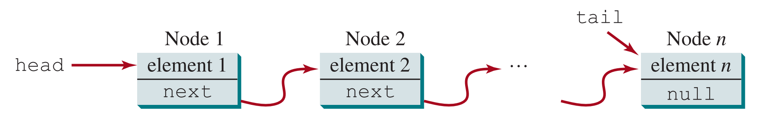
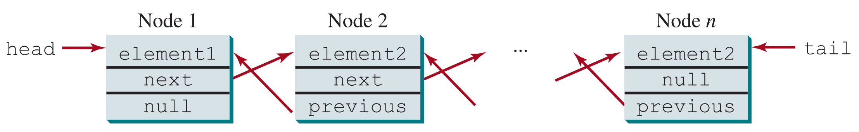
LinkedLists
Singly-linked list (with tail pointer)
Doubly-linked list (with tail pointer)

Slide 323
LinkedList Operations
Two fundamental operations:
  Adding an element
  Removing an element
Three cases:
  Front (beginning of list)
  Middle
  Back (end of list)
Beware of edge cases! When the list has size 0 or size 1, you may encounter null pointer exceptions.

Slide 324
Iterating Over LinkedLists
head
tail
"ATL"
"JFK"
"LAX"
"EWR"
curr

Slide 325
Iterating Over LinkedLists
Node curr = list.head;
while (curr != null && curr.next != null) {
curr = curr.next;
}
curr == list.tail; // This expression is true!
This procedure is especially useful if the linked list does not have a tail pointer.
The same procedure can be used to find and access a specific node in the list.

Slide 326
SLL – addToFront
head
tail
"EWR"
"ATL"
"JFK"
"LAX"

Slide 327
SLL – addToMiddle
head
prev
tail
"ATL"
"JFK"
"LAX"
"EWR"

Slide 328
SLL – addToBack
head
tail
"ATL"
"JFK"
"LAX"
"EWR"

Slide 329
SLL – removeFromFront
head
tail
"ATL"
"JFK"
"LAX"
"EWR"
(Java garbage collection)

Slide 330
SLL – removeFromMiddle
head
prev
tail
"ATL"
"JFK"
"EWR"
"LAX"
(Java garbage collection)

Slide 331
SLL – removeFromBack
head
prev
tail
"ATL"
"JFK"
"EWR"
"LAX"
(Java garbage collection)

Slide 332
Big-: Singly-Linked List with Tail
 | Front | Middle | Back
Add
Remove
Remember to consider both 1) the complexity of traversing to the target position and 2) the complexity of performing the modification itself!

Slide 333
DLL – addToFront
head
tail
"EWR"
"ATL"
"JFK"
"LAX"

Slide 334
DLL – addToMiddle
head
prev
tail
"ATL"
"JFK"
"LAX"
"EWR"

Slide 335
DLL – addToBack
head
tail
"ATL"
"JFK"
"LAX"
"EWR"

Slide 336
DLL – removeFromFront
head
tail
"ATL"
"JFK"
"LAX"
"EWR"
(Java garbage collection)

Slide 337
DLL – removeFromMiddle
head
prev
tail
"ATL"
"JFK"
"LAX"
"EWR"
(Java garbage collection)

Slide 338
DLL – removeFromBack
head
tail
"ATL"
"JFK"
"LAX"
"EWR"
(Java garbage collection)

Slide 339
Big-: Doubly-Linked List with Tail
 | Front | Middle | Back
Add
Remove

Slide 340
Stack ADT
LIFO: Last In First Out
  Elements must be “pushed” (added) to the top of the stack and “popped” (removed) from the top of the stack.
  When you remove an element, you are always removing the newest element.
A stack can be implemented with many backing data structures:
  array, linked nodes, etc.
Example: We learned about the method call stack when discussing recursion and exceptions. Each time a method is invoked, it is pushed to the call stack. The method at the top of the call stack is the first method to be executed.
In Java, the Stack<E> class implements the Collection<E> interface.

Slide 341
Stack ADT
A
B
C
C
B
B
A
A
A
push(A)
push(B)
push(C)
pop()

Slide 342
Queue ADT
FIFO: First In First Out
  Elements must be “enqueued” (added) to the end of the queue and “dequeued” (removed) from the front of the queue.
  When you remove an element, you are always removing the oldest element.
A queue can be implemented with many backing data structures:
  array, linked nodes, etc.
Example: a queue may be useful for processing tasks one-by-one, in order.
In Java, the Queue<E> interface extends the Collection<E> interface.

Slide 343
Queue ADT
front
back
10
25
15
30
front
back
20
10
25
15
30
enqueue(20)
front
back
35
10
25
15
30
20
enqueue(35)
front
back
10
25
15
30
20
35
dequeue()
front
back
25
15
30
20
35
dequeue()

Slide 344
Set ADT
A set is a collection that contains no duplicate elements, i.e. each element is unique.
  Typically, sets are unordered.
A set can be implemented with many backing data structures.
  java.util provides a few implementations:
    HashSet (very efficient)
    LinkedHashSet (slightly less efficient, but supports some ordering)
    TreeSet (least efficient, but supports ordering)

Slide 345
Map ADT
Maps keys to values.
  A map cannot contain duplicate keys. Each key maps to exactly one value.
  Values do not have to be unique.
  Examples:
    GTID → student profile
    word → definition
In Java, the HashMap<K,V> class implements the Map<K,V> interface very efficiently.
Many other languages have similar data structures (such as dictionaries in Python).

Slide 346
HashMap
Recall that the hashCode() method allows us to represent any object as an integer.
A HashMap stores key-value pairs in an array.
  Each key-value pair is stored at an index which is computed from the hashcode of the key.
  Thus, a key-value pair can be retrieved very quickly by computing its index.
  This enables very fast add, remove, and search times.
This is a simplified explanation—you’ll learn more about HashMaps in 1332.

Slide 347
Tree ADT
A tree stores data in nodes that are linked together in a tree-like structure.
There any many different types of trees with different contracts for shape and ordering.
  For example, each node in a binary search tree can have at most two children. All left descendants of a parent node must be smaller than the parent, and all right descendants must be larger than the parent.
  You’ll learn about several types of trees in 1332!
Trees are inherently recursive by definition, but they can be traversed iteratively.

Slide 348
Example: Binary Search Tree
8
3
10
1
6
14
5
7
12

Slide 349
Iterator & Iterable Interfaces
Iterable<T>
  Defines the methods of a collection that can be iterated over
    Iterator<T> iterator(): returns an Iterator<T> object
  A collection that implements Iterable<T> can be iterated over with a for-each loop.
Iterator<E>
  Defines the methods of an object that iterates over a collection
    boolean hasNext(): returns whether there is another element in the iteration
    E next(): returns the next element in the iteration

Slide 350
Example: Iterator & Iterable
import java.util.Iterator;
public class Alphabet implements Iterable<Character> {
public Iterator<Character> iterator() {
return new AlphabetIterator();
}
private class AlphabetIterator implements Iterator<Character> {
private char c = 'a';
public boolean hasNext() {
return c <= 'z';
}
public Character next() {
return c++;
}
}
}
public static void main(String[] args) {
Alphabet alphabet = new Alphabet();
for(char letter : alphabet) {
System.out.print(letter);
}
}
Output:
abcdefghijklmnopqrstuvwxyz

Slide 351
Topic Trivia
1. (T/F) A class can have multiple type parameters.
2. (T/F) We can instantiate an instance of a type parameter.
3. What is the only method required by the Iterable<T> interface?
4. Which ADT follows a FIFO contract?
5. (T/F) A stack must allow you to get an element from the middle.
true
false, because of type erasure
Iterator<T> iterator()
Queue
false

Slide 352
JavaFX Basics
JavaFX classes must extend Application.
You must override the start(Stage primaryStage) method.
  This method takes in a Stage object and sets up objects in the GUI (graphical user interface).
The main method should call launch(args) to create the GUI.
  The main method is optional, unless you’re using an IDE with limited JavaFX support.
You must import classes from the javafx package.
  import javafx.application.Application;
  import javafx.stage.Stage;

Slide 353
Example: JavaFX Basics
import javafx.application.Application;
import javafx.stage.Stage;
public class FXDemo extends Application {
/* Main method is not required,
unless you're using an IDE
with limited JavaFX support. */
public static void main(String[] args) {
launch(args);
}
@Override
public void start(Stage primaryStage) {
// display the stage!
primaryStage.show();
}
}

Slide 354
JavaFX & Javadocs
The JavaFX library is vast! You are not expected to memorize every method of every class.
You should frequently reference documentation during development to learn how to use a class and its methods.
  Search online for “<class name> javafx 11”
  https://openjfx.io/javadoc/11/
Using libraries and reading documentation is an important skill!

Slide 355
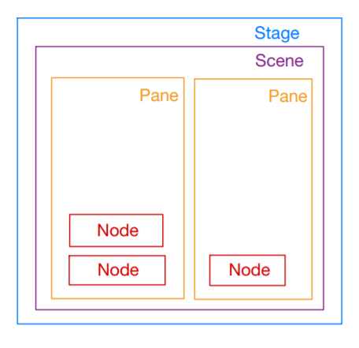
Components of a JavaFX Program
Stage: window in which the program opens; holds all other components
  Primary stage is automatically created and passed to the start() method.
Scene: placed within a stage; contains elements (Node objects) in a scene graph with a root Node at the top
Pane: area within a scene for placing and arranging GUI elements
Node: visual component, e.g. shape, image view, UI control, pane, etc.

Slide 356
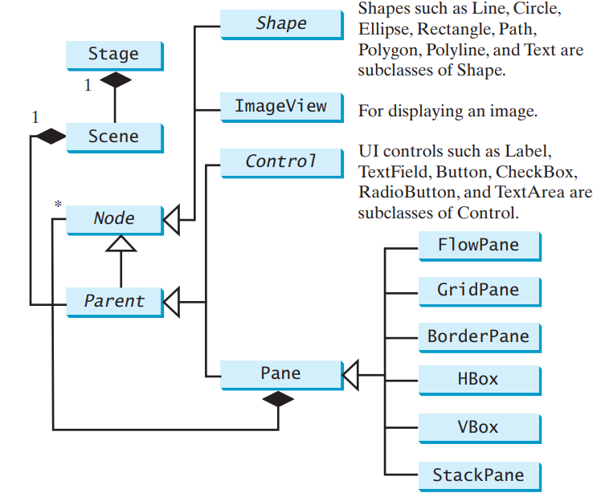
JavaFX Stage Hierarchy

Slide 357
Shapes
The Shape class is an abstract class that extends Node.
  Base class for all Shape classes: Circle, Rectangle, Line, Arc, etc.
The Shape class defines fill, stroke, and strokeWidth properties, and each specific shape has its own properties.
(0, 0)
(400, 300)
import javafx.scene.shape.Rectangle;
// ...
Rectangle rect = new Rectangle(400, 300, 20, 30);
rect.setFill(Color.GREEN);
height = 30
width = 20

Slide 358
Colors
There are several ways to specify a color using the Color class.
Constructor:
  Color(double red, double green, double blue, double opacity)
    double inputs must be in the interval [0.0, 1.0]
Static methods:
  Color.rgb(int red, int green, int blue)
  Color.rgb(int red, int green, int blue, double opacity)
    int inputs must be in the interval [0, 255]
Predefined constants:
  Color.RED, Color.GREEN, Color.DEEPSKYBLUE

Slide 359
Example: Colors
// Three representations of the same blue color:
// 1. Color constructor
Color blue1 = new Color(0, 0, 1, 1);
// 2. static method rgb()
Color blue2 = Color.rgb(0, 0, 255, 1);
// 3. Color.BLUE constant
Color blue3 = Color.BLUE;

Slide 360
Images
The Image class is an abstract representation of an image at a path or URL.
The ImageView class extends Node and is used to display images that have been loaded with an Image instance.
To display an image, you must create an ImageView object and pass in an Image object.
Image image = new Image("images/cs1331logo.png");
ImageView imageView = new ImageView(image);

Slide 361
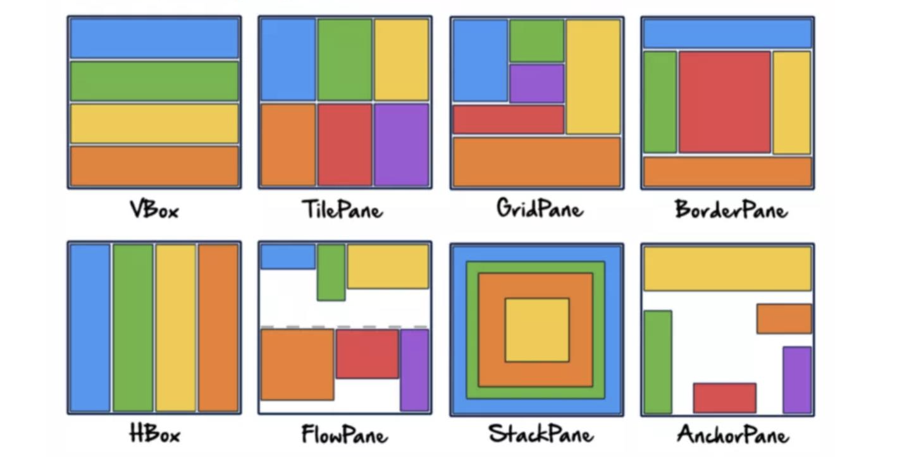
Panes
Panes are GUI layout managers that control how components are arranged.
Pane extends from Node and serves as the base class for all layout panes.
Add nodes to a pane by calling the getChildren() method, which returns an editable list of child nodes.

Slide 362
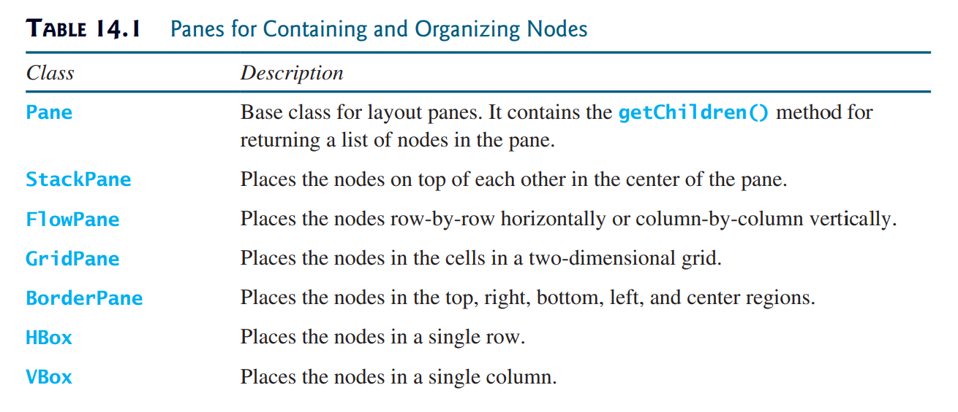
Panes

Slide 363
Example: JavaFX Application
public class Sample extends Application {
@Override
public void start(Stage primaryStage) {
// create nodes
// create pane and add nodes to pane
Pane pane = new Pane();
pane.getChildren().add(Node element);
pane.getChildren().addAll(Node... elements);
// create scene graph with root pane (can specify dimensions)
Scene scene = new Scene(pane, double width, double height);
// set title of primary stage and place the scene in the stage
primaryStage.setTitle("Title");
primaryStage.setScene(scene);
primaryStage.show(); // display the stage!
}
}

Slide 364
Event-Driven Programming
Event-driven programming is a programming paradigm in which the flow of the program is determined by external events.
  This paradigm is frequently used in GUI applications, since they are designed to allow users to interact with the program.
An event is a signal to the program that something has happened.
  Events can be triggered by external actions (such as mouse movements, mouse clicks, keystrokes) or messages from other programs or threads.
  The event source object is the component that creates and fires the event.
Events are handled by event handlers, which are registered with an event source object to define what the program does when the event occurs.

Slide 365
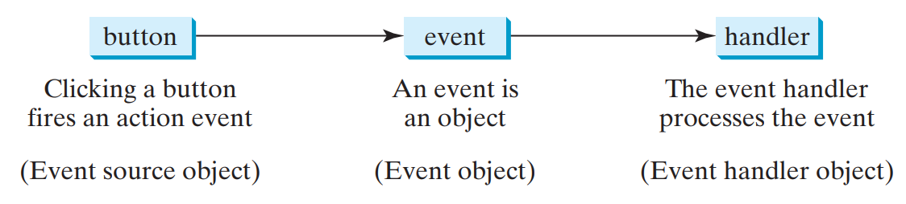
Event-Driven Programming

Slide 366
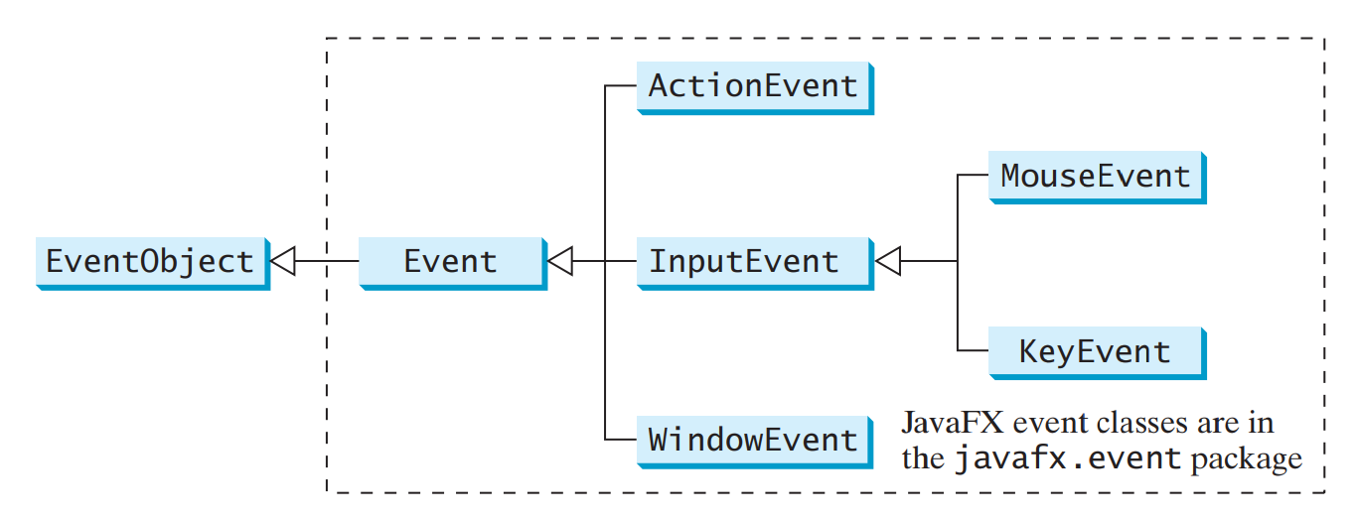
Event Objects
An Event object contains information about the event that occurred.
  All Event objects have a getSource() method that allows you to retrieve the event source object that fired the Event.

Slide 367
Mouse Events
Mouse events are fired when a mouse action occurs.
  Examples: pressing, releasing, or clicking a mouse button; moving or dragging the mouse
Use the getButton() method to get the mouse button that was responsible for the event.
The MouseEvent class also defines constants that provide information about the event.
  Examples: MOUSE_PRESSED, MOUSE_RELEASED, MOUSE_CLICKED, MOUSE_MOVED, MOUSE_DRAGGED
  Note: a mouse button is clicked when it is pressed and released

Slide 368
Useful MouseEvent Methods
Method​ | Description​
getButton()​ | Returns the MouseButton that was responsible for the event (if any).
getX() | Retur​ns the horizontal position of the mouse event relative to the event source object.
getY() | Returns the vertical position of the mouse event relative to the event source object.
getClickCount() | Returns the number of mouse clicks associated with this event.
isShiftDown() | Returns whether the Shift modifier is down on this event.
isControlDown() | Returns whether the Control modifier is down on this event.

Slide 369
Key Events
Key events are fired when a key is pressed, released, or typed.
Use the getCode() method to get the KeyCode enum constant value identifying the key that was responsible for the event.
The KeyEvent class also defines constants that provide information about the event.
  Examples: KEY_PRESSED, KEY_RELEASED, KEY_TYPED
  Note: a key is typed when it pressed and released

Slide 370
Useful KeyEvent Methods
Method​ | Description​
getCode() | Returns the key code associated with a key pressed or key released event.
getCharacter() | Returns the character or sequence of characters associated with the key typed event.
getText() | Returns a String describing a particular key code for key pressed or key released events.
isShiftDown() | Returns whether the Shift modifier is down for this event.
isControlDown() | Returns whether the Control modifier is down for this event.

Slide 371
EventHandler Objects
The responsibility of processing the Event object is delegated to an EventHandler object.
An EventHandler must be registered with an event source object:
  Must implement the EventHandler interface with the correct type T to handle the Event.
  Must be registered with an event source object using a registration method (e.g. setOnAction(), setOnMouseClicked()).
public interface EventHandler<T extends Event> {
void handle(T event);
}
EventHandler is a functional interface!

Slide 372
Example: Event & EventHandler
public class ButtonHandler implements EventHandler<ActionEvent> {
public void handle(ActionEvent event) {
System.out.println("Hello!");
}
}
public class Demo extends Application {
@Override
public void start(Stage primaryStage) {
Button btn = new Button(); // event source object
ButtonHandler handler = new ButtonHandler(); // event handler
btn.setOnAction(handler); // registering the handler
}
}

Slide 373
Nested Inner Classes
public class Enclosing {
private int x;
private class Inner {
private int y;
void method2() {
Enclosing enclosing = new Enclosing();
System.out.println(enclosing.x);
enclosing.method1();
}
}
private void method1() {
Enclosing a = new Enclosing();
Inner b = a.new Inner();
System.out.println(b.y);
b.method2();
}
}
An instance of Inner can exist only within an instance of Enclosing. To instantiate an inner class, you must first instantiate the outer class.

Slide 374
Anonymous Inner Classes
An anonymous inner class is similar to an inner class, but does not have a class name.
Anonymous inner classes can make your code more concise because they allow you to define and instantiate a class at the same time!
However, using an anonymous inner class can hinder readability. Also, you cannot reuse the class because it has no name.
  Anonymous inner classes are useful for one-time-use event handlers!
An anonymous inner class must extend a superclass or implement an interface.

Slide 375
Example: Anonymous Inner Class
public abstract class Animal {
private String name;
private String color;
public Animal(String name, String color) {
this.name = name;
this.color = color;
}
public Animal() {
name = "animal1";
color = "blue";
}
public abstract void makeNoise();
// continued...
public void eat() {
System.out.printf("Animal %s is eating!\n",
name);
}
public String toString() {
return String.format("Animal: %s, Color: %s",
name,
color);
}
public String getName() {
return this.name;
}
}

Slide 376
Example 1
System.out.println(new Animal("Dog", "Orange") {
public void makeNoise() {
System.out.println("Anonymous Animal 1 making noise!");
}
});
Output: Animal: Dog, Color: Orange
Defines and instantiates an anonymous class that extends the abstract class Animal and prints the toString() of the instance.
Since the makeNoise() method is declared abstract in the parent class, we must provide an implementation (even though we don’t use it here!).

Slide 377
Example 2
new Animal() {
public void makeNoise() {
System.out.println("Anonymous Animal 2 making noise!");
}
public void eat() {
System.out.println(this.getName() + " EEAATTTTing!");
}
}.eat();
Output: animal1 EEAATTTTing!
Defines and instantiates an anonymous class that extends the abstract class Animal and invokes the eat() method on the instance. At runtime, the override is invoked.

Slide 378
Example 3
Animal a2 = new Animal("Cat", "Calico") {
public void makeNoise() {
System.out.println("Meow meow meow!");
}
};
a2.eat();
a2.makeNoise();
Output: Animal Cat is eating!
Meow meow meow!
Defines and instantiates an anonymous class that extends the abstract class Animal and stores a reference to the anonymous instance in a reference variable of type Animal.

Slide 379
Event Handling: Inner Classes
public void start(Stage primaryStage) {
button.setOnAction(new ButtonHandler());
}
class ButtonHandler
implements EventHandler<ActionEvent> {
public void handle(ActionEvent event) {
System.out.println("Hello!");
}
}
Inner Class
public void start(Stage primaryStage) {
button.setOnAction(new EventHandler<ActionEvent>() {
public void handle(ActionEvent event) {
System.out.println("Hello!");
}
});
}
Anonymous
Inner Class

Slide 380
Lambda Expressions
A lambda expression is a syntactical abbreviation for an anonymous inner class.
  Acts like an anonymous method implementation
  Allows you to pass functionality as an argument to another method
Lambda expressions can only be used to implement an interface with a single abstract method (a functional interface).

Slide 381
Lambda Expression Syntax
1. Parameter list: (type1 param1, type2 param2, ...)
  Data types can be omitted, since a functional interface has exactly one method. If there is only one parameter, then the parentheses can be omitted too.
2. Arrow token: ->
3. Body: implementation of the abstract method defined in the functional interface
  { statements; }
  If the body contains a single expression, it will be evaluated, and its value will be returned. Curly braces and semicolon can be omitted.
  If the method body contains a single void method invocation, you can also omit the curly braces and semicolon.

Slide 382
Lambda Expression vs. Inner Class
public interface Echoable {
String echo(String toEcho);
}
Echoable echoer1 = new Echoable() {
public String echo(String toEcho) {
System.out.println(toEcho +
", " +
toEcho);
return "Echoed: " + toEcho;
}
};
echoer1.echo("Anonymous");
Echoable echoer2 = toEcho -> {
System.out.println(toEcho + ", " +
toEcho);
return "Echoed: " + toEcho;
};
echoer2.echo("Lambda");
Output: Anonymous, Anonymous
Output: Lambda, Lambda

Slide 383
Event Handling: Lambda Expressions
@Override
public void start(Stage primaryStage) {
btnNew.setOnAction((ActionEvent event) -> {
System.out.println("Process New");
});
btnOpen.setOnAction((event) -> {
System.out.println("Process Open");
});
btnSave.setOnAction(event -> {
System.out.println("Process Save");
});
btnPrint.setOnAction(event -> System.out.println("Process Print"));
}
The data type can be inferred from the function call, since a functional interface has only one method.
If there is only one parameter, you can omit the parentheses.
If there is only one line (either a void method call or a return value), then you can omit the curly braces.

Slide 384
Example: Lambda Expressions
ArrayList<Integer> ints = new ArrayList<>();
for (int i = 1; i <= 10; i++) {
ints.add(i);
}
System.out.println(ints); // [1, 2, 3, 4, 5, 6, 7, 8, 9, 10]
ints.removeIf(e -> e % 2 == 0); // remove element e if e % 2 == 0
System.out.println(ints); // [1, 3, 5, 7, 9]
ints.sort((a, b) -> b - a); // b – a < 0 when b < a
// (sorts in descending order)
System.out.println(ints); // [9, 7, 5, 3, 1]

Slide 385
Topic Trivia
1. What method is used to run a JavaFX application?
2. What class must all JavaFX applications extend from?
3. (T/F) We can display an image by adding an Image to a pane.
void start(Stage)
Application
false

Slide 386
Topic Trivia
4. (T/F) In a JavaFX application, stages are placed within a scene.
5. (T/F) To display an Image, you must pass a File object referencing the image file into the Image constructor.
6. If we want to display five UI elements with one in the center and one on each edge, which pane would be best?
7. (T/F) A lambda expression can be written in place of any anonymous inner class.
False. Scenes are placed within a Stage.
False. The Image constructor loads the image at the input String URL. Then, construct an ImageView object to place the image in a Scene to display it.
BorderPane
False. Lambda expressions can only be used to implement functional interfaces.

Slide 387
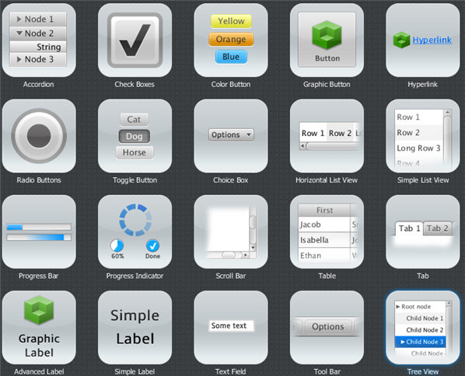
UI Controls
UI controls are graphical components that allow users to interact with the program.
UI Controls Tutorial

Slide 388
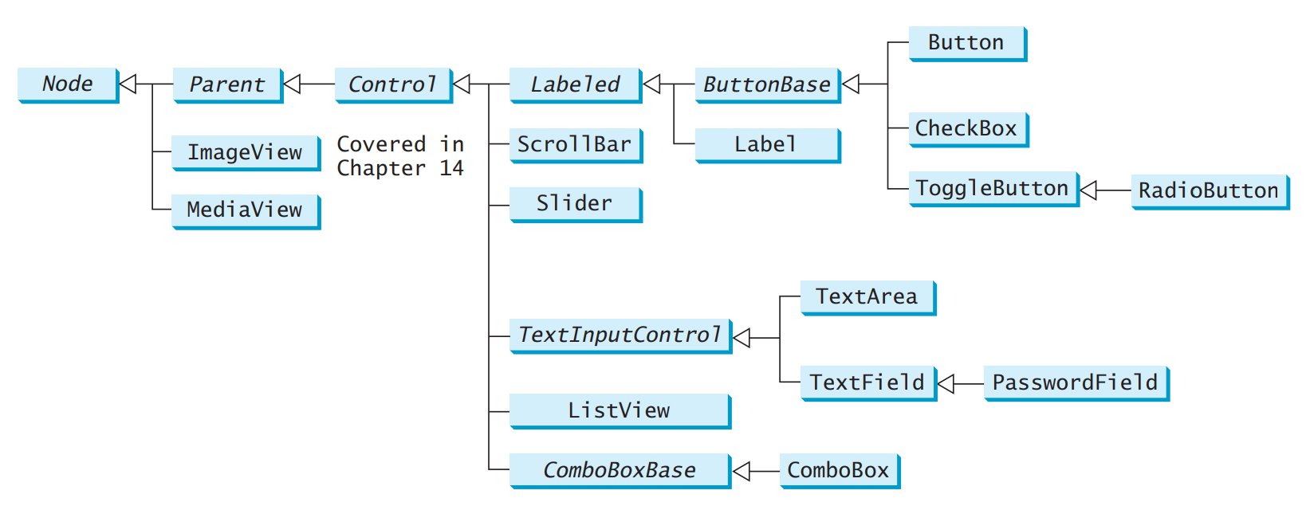
UI Controls: Overview

Slide 389
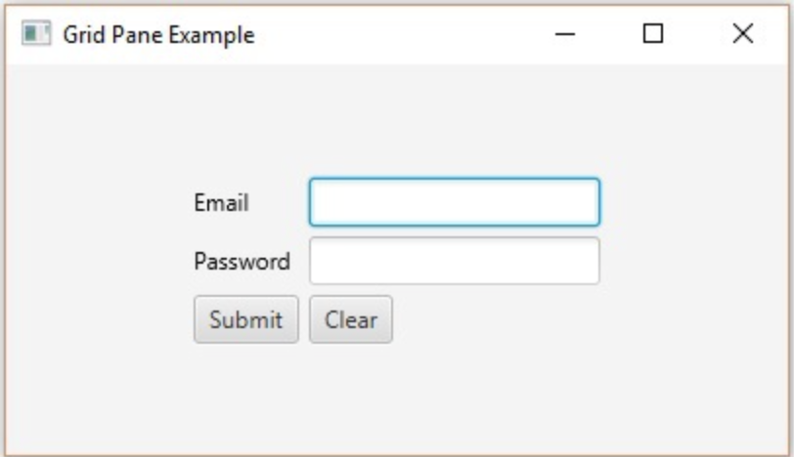
Labels & Buttons
Label
Label: non-editable text label
Button: labeled button
  Applications can cause an event to occur when a button is pressed (event handling).
There are many more UI controls. Read the documentation to learn what they do and how to use them!
Button
TextField
https://docs.oracle.com/javafx/2/ui_controls/jfxpub-ui_controls.htm

Slide 390
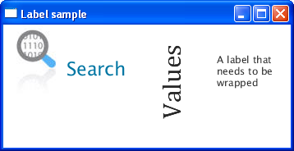
Label
A label is a non-editable text control.
  A label can also display a graphic, such as an image or another node.
  You can modify font, scale, rotation, alignment, text wrapping, etc.

Slide 391
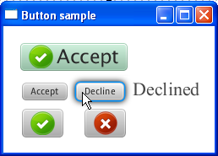
Button
A button is an actionable control that triggers an ActionEvent when clicked.
  A button can contain text and/or a graphic.
  When a button is clicked, it fires an ActionEvent. Use the method setOnAction(EventHandler<ActionEvent> handler) to determine what happens when a button is clicked.

Slide 392

Checkbox
A checkbox allows the user to make a selection, denoted by a checkmark.
  When a checkbox is clicked, it will be either checked or unchecked, and it will it fire an ActionEvent.
  To determine if a checkbox is selected, use the isSelected() method.
  You can use the same event handler for a group of checkboxes to determine how to handle various combinations of selected checkboxes.

Slide 393
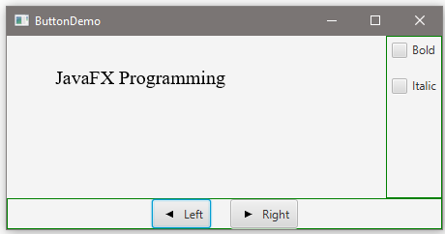
Example: Checkbox
EventHandler<ActionEvent> handler = e -> {
if (chkBold.isSelected() && chkItalic.isSelected()) {
text.setFont(fontBoldItalic);
} else if (chkBold.isSelected()) {
text.setFont(fontBold);
} else if (chkItalic.isSelected()) {
text.setFont(fontItalic);
} else {
text.setFont(fontNormal);
}
};

Slide 394
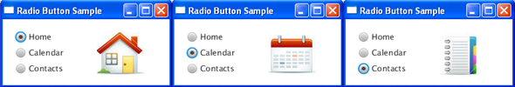
RadioButton
A radio button allows the user to choose a single item from a group of mutually exclusive choices.
  A radio button is either filled (if selected) or blank (if not selected).
  To program the one-of-many behavior, create a ToggleGroup to manage the single-selection behavior. Set the ToggleGroup of each RadioButton using the rb.setToggleGroup(group) method.

Slide 395
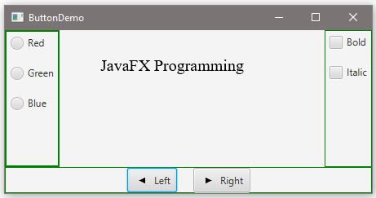
Example: RadioButton
ToggleGroup group = new ToggleGroup();
rbRed.setToggleGroup(group);
rbGreen.setToggleGroup(group);
rbBlue.setToggleGroup(group);
rbRed.setOnAction(e -> {
if (rbRed.isSelected()) {
text.setFill(Color.RED);
}
});
// similarly for rbGreen and rbBlue

Slide 396
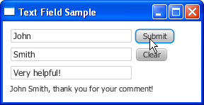
TextField
A text field accepts and displays user input.
  A text field can receive text input from the user in a single line entry.
    Use the getText() method to get user input.
  If the Enter key is pressed when the cursor is in a text field, it fires an ActionEvent.

Slide 397
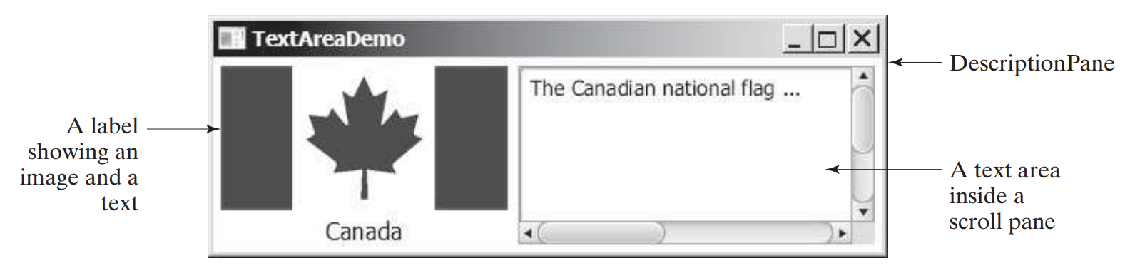
TextArea
Use a text area to allow the user to enter multiple lines of text.
  It is often useful to create a ScrollPane object and place a TextArea inside it to support scrolling.

Slide 398
ComboBox
A ComboBox allows users to select one of several options from a dropdown list.
  When the number of items exceeds a limit, it automatically adds scrolling to the dropdown list.
Instantiate a ComboBox using generics:
ComboBox<String> combo = new ComboBox<>();
To add elements, use the addAll() method:
combo.getItems().addAll("1331", "1332", "2340");
Selecting an item fires an ActionEvent.

Slide 399
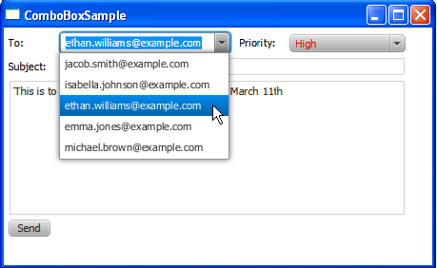
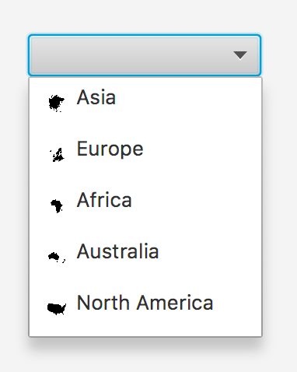
Example: ComboBox

